Slide 1
Badger returns usability testing share back
Published: Sept 2023
Classification: OFFICIAL
Version: 1.0

Slide 2
Background
In the UK, or development work near badger setts (burrows), requires a licence. The licence mandates an ecologist to undertake work to mitigate the impact on badgers. The ecologist is hired by the person or entity undertaking the development.
To obtain a licence, the ecologist must apply to Natural England, who review the ecologist's application and decide whether to grant the licence.
Once they complete mitigation work, ecologists submit a Report of Action, form L24, otherwise known as the Returns process.
This report presents usability test findings for an online Returns process prototype.
Notes:
In the UK, construction near badger setts requires a license.
The license mandates ecologists to minimize badger impact and is obtained by applying to Natural England.
Ecologists submit a Report of Action to ensure work compliance.
This report is known as the Returns process (form L24).
This report presents usability test findings for an online Returns process prototype.

Slide 3
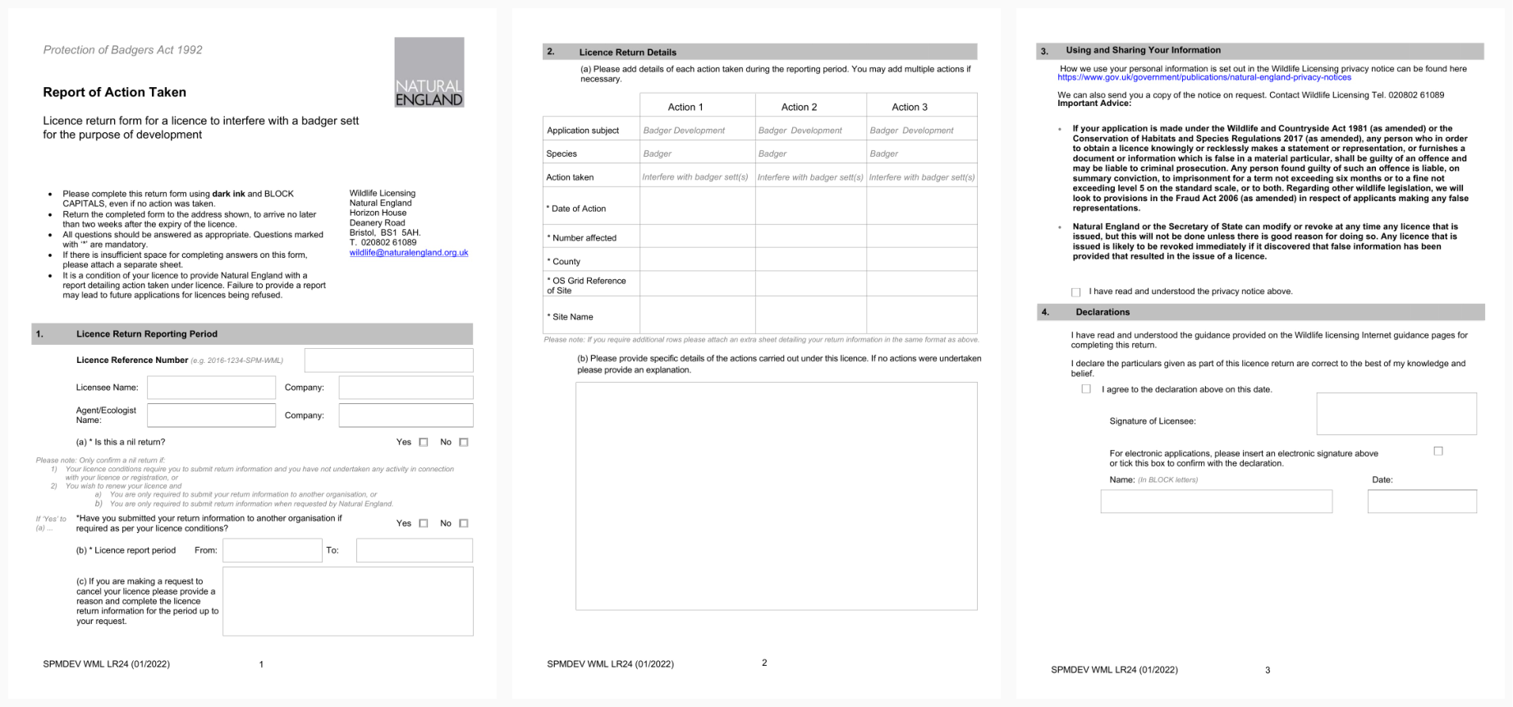
Existing L24 Report of Action taken form

Slide 4
Research aims
Test the usability of the Returns flow.
Additionally, to answer the following overarching questions:
How do ecologists collect the information to complete a Report of Action?
How do ecologists submit a Report of Action?
Is the Returns flow intuitive to Ecologists?
Identify problems in the design of the badger L24 report of action service
Uncover opportunities to improve the design
More details questions for the Returns usability testing can be found in the research plan.

Slide 5
Assumptions and hypotheses
It is only ecologists who will fill out or submit a Report of Action taken.
Users of the Report of Action prototype have access to an internet enabled device at the time of completing and submitting it.
The Report of Action prototype will be a faster, more accessible alternative to the current L24 Report of Action form.
The Report of Action prototype will be usable for users.

Slide 6
Method
30 minutes semi structured interview with ecologists exploring:
How a Report of Action is submitted
Who is involved - in particular, what is the role of Applicants?
Experiences of submitting a Report of Action taken to NE
Followed by a 30-minute usability test of the Report of Action taken flow

Slide 7
Who did we speak to?
We spoke with 5 ecologists, following a convenience sample, who were recruited from a list of ecologists identified by NE as having submitted a badger licence within the past 24 months.
All had submitted a Report of Action in the recent (within 12 months) past.
Participants came from a mixture of larger organisations, smaller (1-3 people) and single person organisations.
All participants were more experienced and were either Principal Ecologists within their organisations or seasoned ecologists.

Slide 8
Research limitations
Lack of up-front user research meant tasks created in the absence of knowledge about user needs and unclear metrics.
Research carried out only with experienced ecologists
Isolated 'returns flow' testing limited understanding of the complete user experience.
Recruitment challenges hindered realistic scenario testing, affecting participant experience.
Variation in page testing due to participant choices.
Limited user knowledge necessitates further discovery-style research to validate identified themes.
Notes:
Assessing various designs without up-front user research suggests undiscovered opportunities in the report of action process.
Testing the 'returns flow' in isolation prevented a comprehensive understanding of the complete user experience.
Given difficulties accessing participants, it would have been unfeasible to recruit participants who had experienced the exact scenarios we used to test the prototype, therefore, participants were not in possession of information they otherwise would be in reality if completing a Report of Action form, such as the licence application form and their survey and mitigation report.
Not all the same pages were tested during each session, since participants were allowed to take the session where they wanted, depending on their answers.
Knowledge about our users is still limited at this point. Further discovery style research is required to validate some of the identified themes.

Slide 9
How we've categorised the findings
We've categorized usability issues into three levels of impact on users:
High impact
Medium impact
Low impact
Although we initially used this research to evaluate design usability, our limited prior knowledge of user behaviours and expectations led us to use the research as an opportunity to gain insights about our users. Instead of a traditional usability test with multiple tasks and associated metrics, we conducted a cognitive walkthrough session focused on a single task (completing a report of action). While this resulted in more subjective measures of impact, the approach allowed us to better understand our users while evaluating usability.

Slide 10
Usability issues
The Returns flow has 23 usability issues across the 27 pages.
The usability problems differ in severity and type of impact to the user's experience:
High impact to the user
Medium impact to the user
Low impact to the user
= 4
= 8
= 9
An example of one high impact usability problem involving multiple pages
"It's not clear which sett is being referred to at any one time."

Slide 11
What we learned from usability testing the Report of Action online form

Slide 12
Key themes
The context of Ecologists' work
The dynamic nature of construction work and wildlife
Challenges in providing conclusive evidence due to limitations when monitoring wildlife
2. Ecologists' unmet needs, the Returns process and usability gap in between
Lack clarity on Natural England's assessment process.
Provide transparency to license holders.
Keep records for auditing purposes.
3. Standalone usability issues

Slide 13
The context of ecologists' work

Slide 14
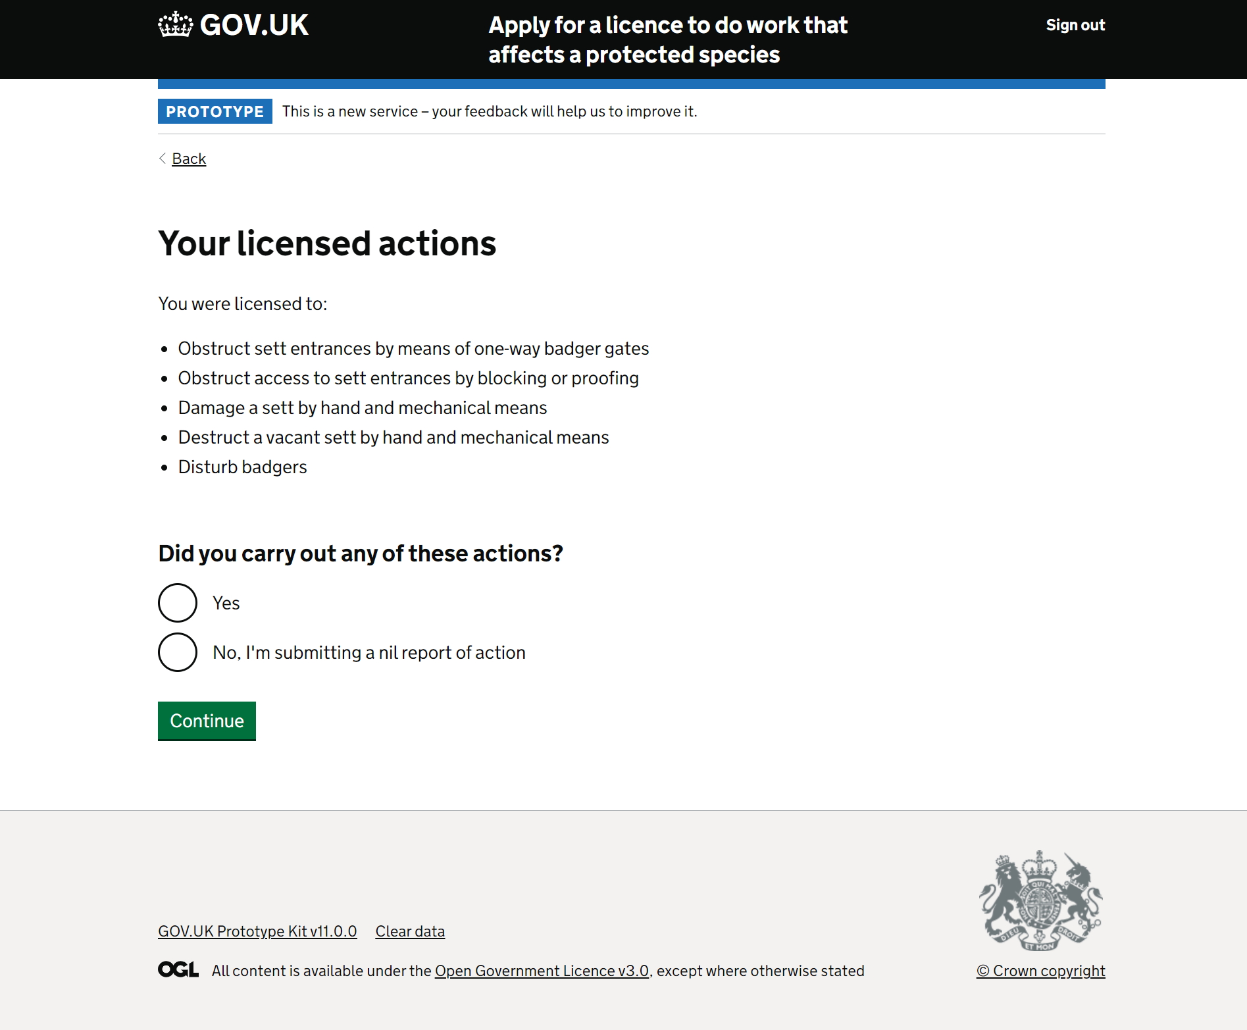
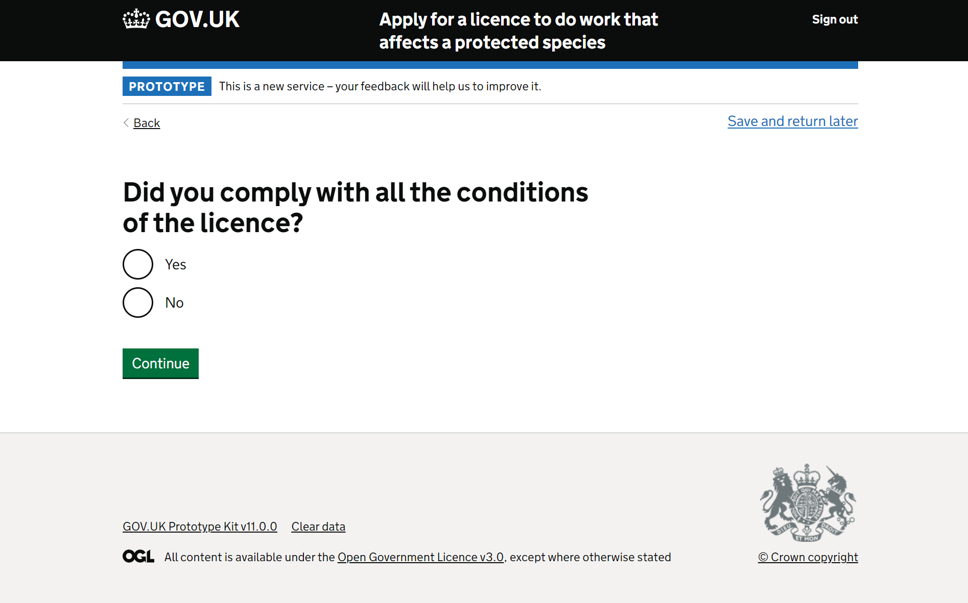
The dynamic nature of construction work and wildlife
Ecologists navigate a dynamic development environment where unexpected changes can disrupt their work, especially at the intersection of construction and nature.
Adapting to on-site shifts in natural conditions while meeting the needs of clients, Natural England, and wildlife poses a complex challenge.
Adapting to perceived binary processes poses a challenge; flexibility is essential.
"You['ve said in the licence application] that you were going to use a 1-metre wide and half a metre deep digger bucket with no teeth to excavate the soil. But having got down a metre you found that there was a large lump of concrete there, which meant that you needed to change the digger bucket to a toothed bucket to be able to lift the blasted thing or get some sort of strop under it and lift it up with a different machine." P4

Slide 15
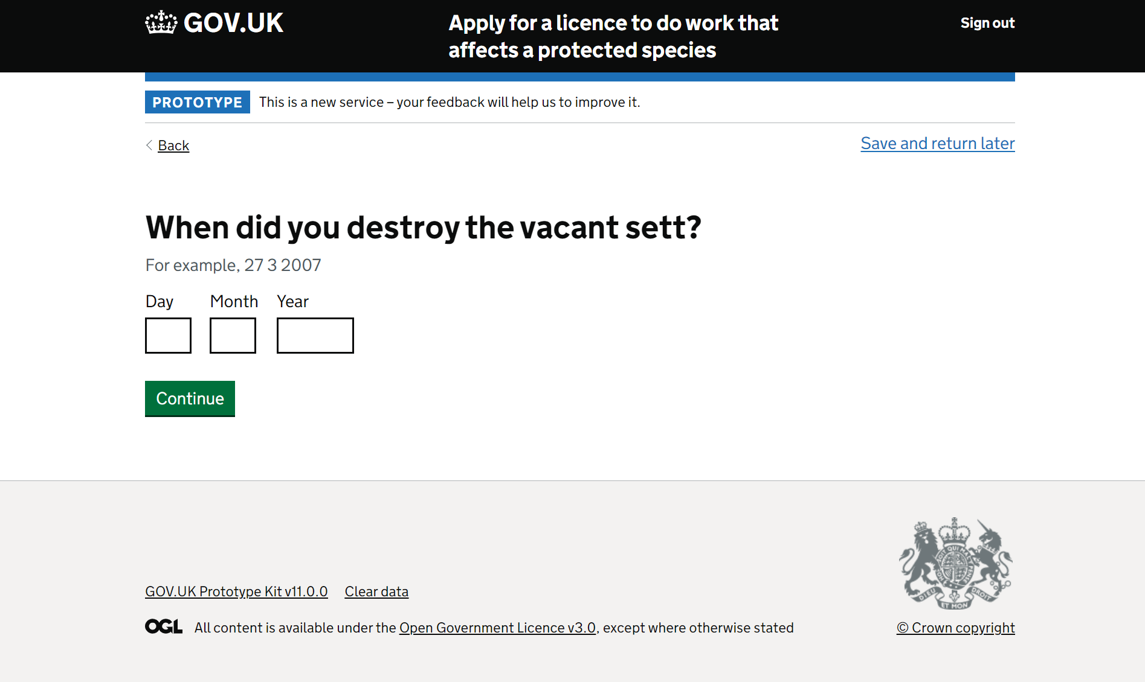
b. A challenge providing conclusive evidence due to limitations when monitoring wildlife
Given the unpredictable nature of wildlife, and limitations in properly monitoring badgers, it can be challenging providing conclusive evidence of their behaviour.
"What you want to happen is that there are badgers in the sett. Because if there aren't badgers in the sett, then you've never really sure that there definitely aren't badges in the sett and they haven't got some other way in and out. So, you want your sand traps to show initial activity all going one way because once the gates are set to one way, hopefully the badgers are just going out and you shouldn't have any paw prints going back in. So after about four days you hope that... more or less activities have wound down, they've all left and then you're confident. But the thing is that, is the set is actually empty?" P4

Slide 16
A challenge providing conclusive evidence due to limitations when monitoring wildlife
Every participant comprehended the 'nil report of action' option.
During the testing, it became evident that ecologists often faced ambiguity and encountered grey areas in their work.
At times, the 'yes' and 'no' options were clear, but participants felt they fell short when partial actions occurred under these choices without completing them entirely.
"There's no partial action for destroying part of a sett" P1

Slide 17
2. Ecologists' unmet needs, the Returns process and usability gap in between

Slide 18
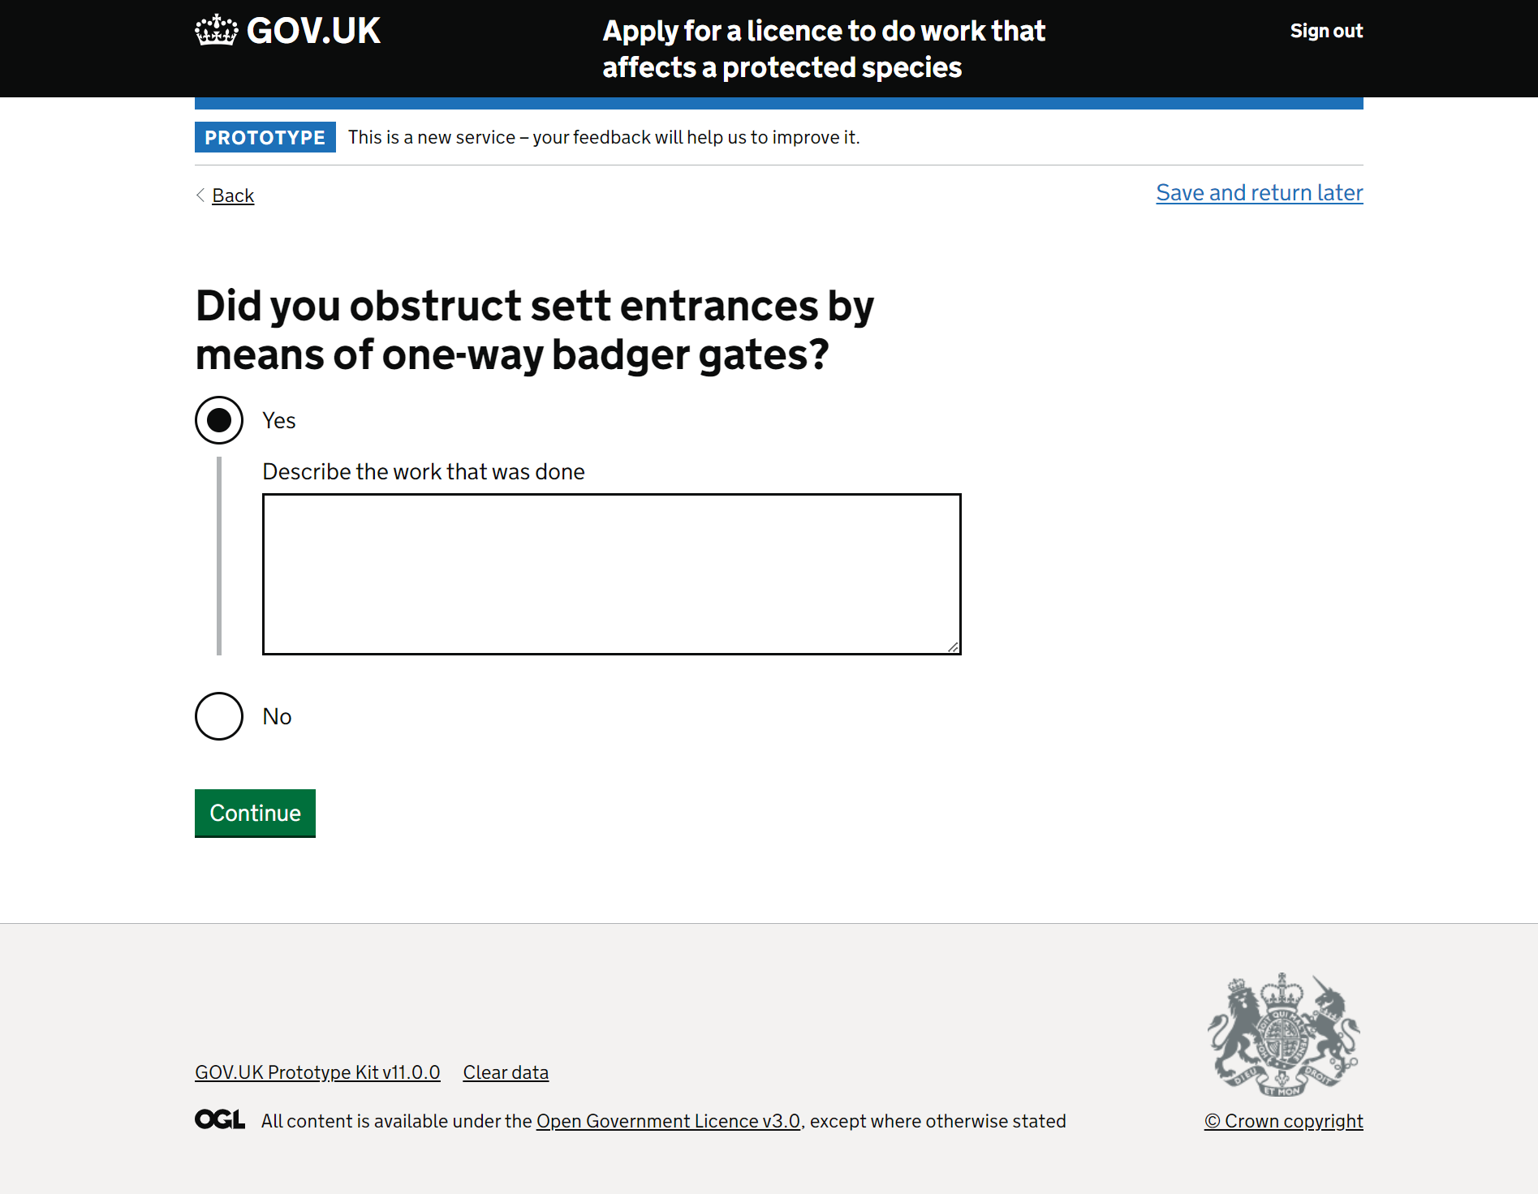
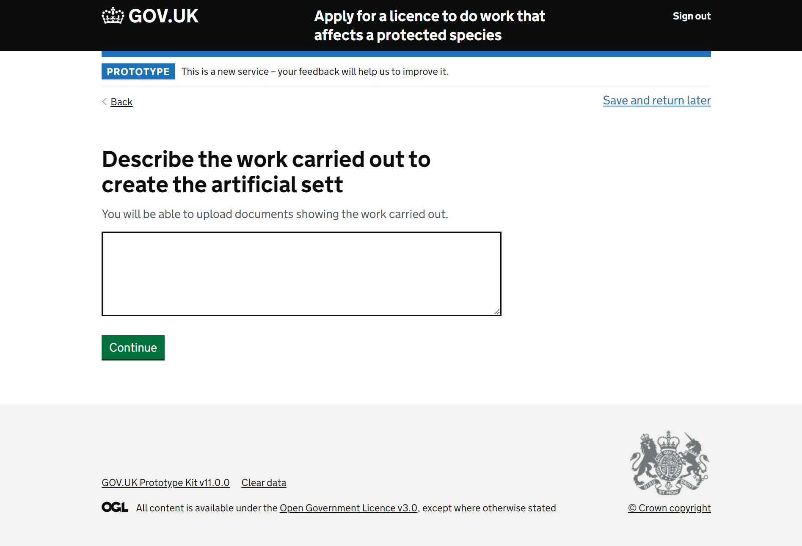
Ecologists lack clarity on Natural England's assessment process
Participants expressed anxiety due to a lack of clarity about Natural England's assessment process.
This uncertainty raised concerns about providing either incorrect or insufficient evidence, potentially causing delays.
We tended to observe this uncertainty when participants encountered questions requesting evidence or where they believed evidence might be valuable, often in free text boxes.
"What are they wanting me to describe?... I want to be honest, but I don't want to someone to come back and question the variations." P3
"There's not a clear picture of what's wanted or needed." P2

Slide 19
Ecologists lack clarity on Natural England's assessment process
Pages this caused confusion for:
1. did you obstruct sett entrances by means of one-way badger gates?
2. did you obstruct sett entrances by blocking or proofing?
3. did you damage a sett by hand and mechanical means?
4. did you destroy a sett by hand and mechanical means?
5. describe the work carried out to create the artificial sett.
6. was the artificial sett created before the licensed sett was closed?
7. what evidence do you have that badgers found the artificial sett?
9. did the work carried out under the licence cause any concerns to badgers' welfare?
10. when did you destroy the vacant sett?
11. did you disturb badgers?
12. describe the work carried out to create an artificial sett
13. do you want to upload supporting information?

Slide 20
Participants felt suspicious of some questions, afraid of giving too much away.
The purpose behind the question and the required information to include were not entirely evident to participants.
This initiated a recurring theme where participants aimed to strike a balance in sharing information with NE to provide enough for utility but avoiding excess that might prompt NE to question their actions or raise legal challenges.
Participants were concerned about scrutiny, challenges, possible sanctions and delay in receiving a licence.
"What are they wanting me to describe?... I want to be honest, but I don't want to someone to come back and question the variations." P3

Slide 21
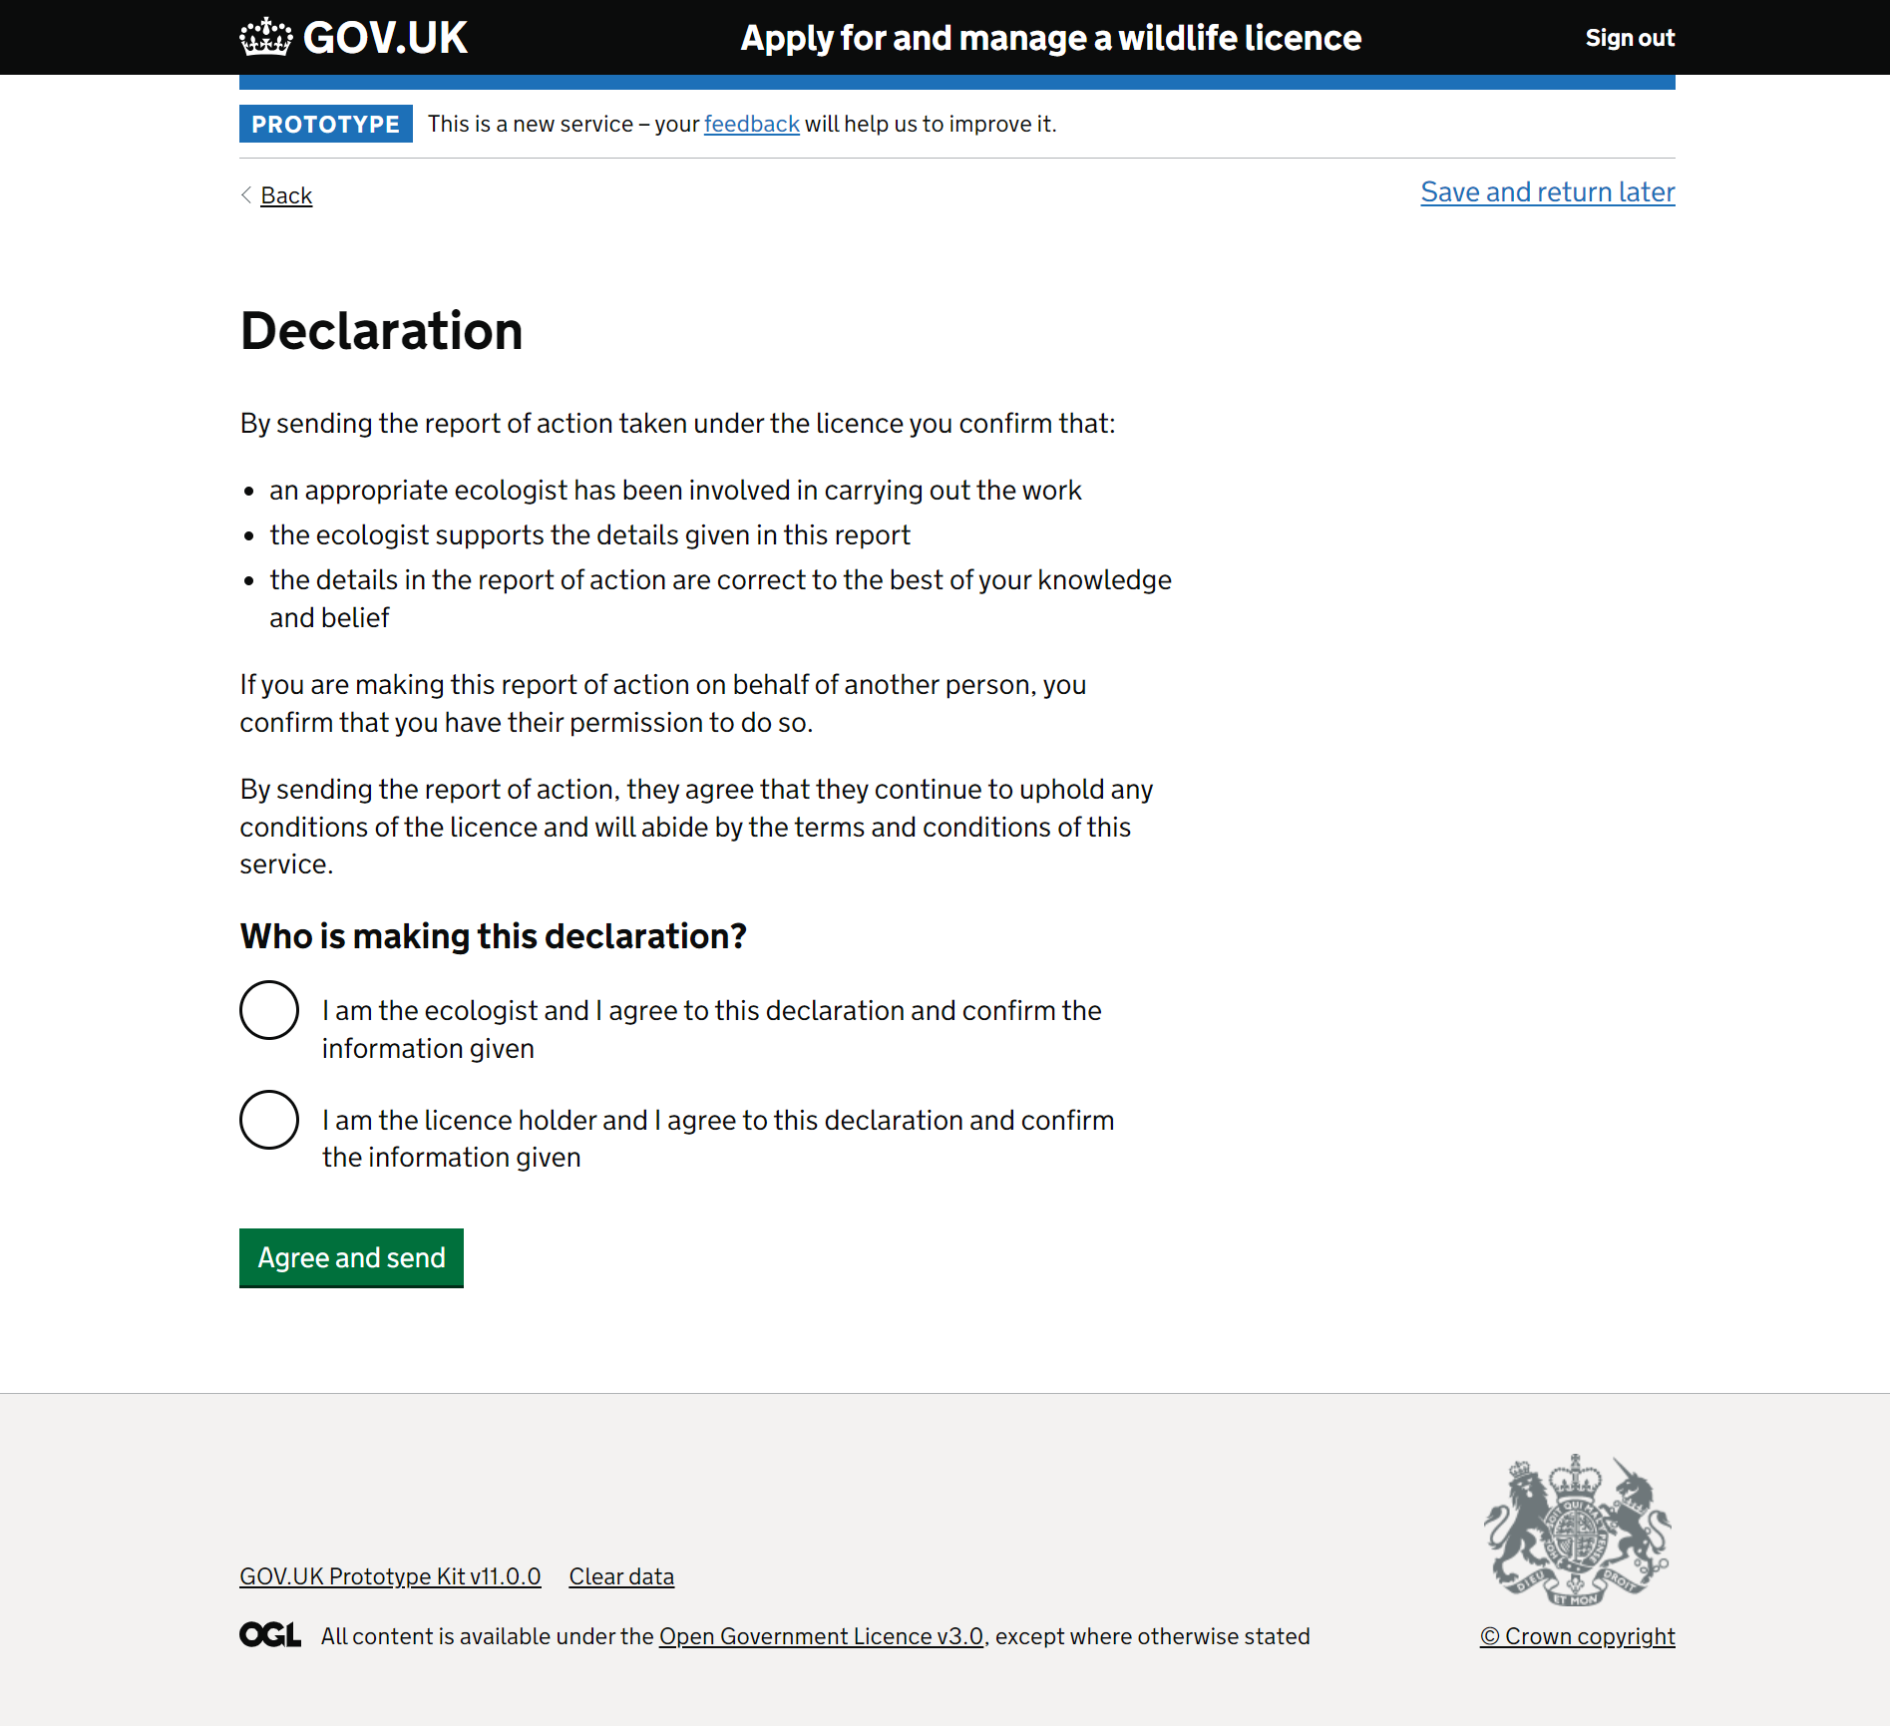
b. Ecologists provide transparency to licence holders
Some ecologists offer transparency to license holders when submitting the Report of Action form because the license holder is legally accountable for the reported actions.
The approach varies based on the ecologists' preference and the client's availability.
Some ecologists would prefer not to submit the form rather than sign on behalf of a client without their visibility or consent.

Slide 22
How ecologists provide transparency for their clients (licence holders)
Participants assumed developers would be the license holders during testing.
1
Have them to sign off before submitting
2
Call and have them verbally confirm before submitting
3
Submit and send to them to ratify

Slide 23
Inspiration for providing transparency from ecologists
When faced with a new, more restrictive, process that would break their existing workaround solutions, participants suggested different solutions.
"An opportunity to download what you've entered and then send that to the licence holder." P2
Note: these are solution suggestions for consideration and inspiration only. We may discovery an even smarter way of solving this problem.
1
Open access to licence holders to complete
2
Complete, then share a copy of the form prior to submitting
3
Submit and send to them to ratify
"Does it need a double tick" P3

Slide 24
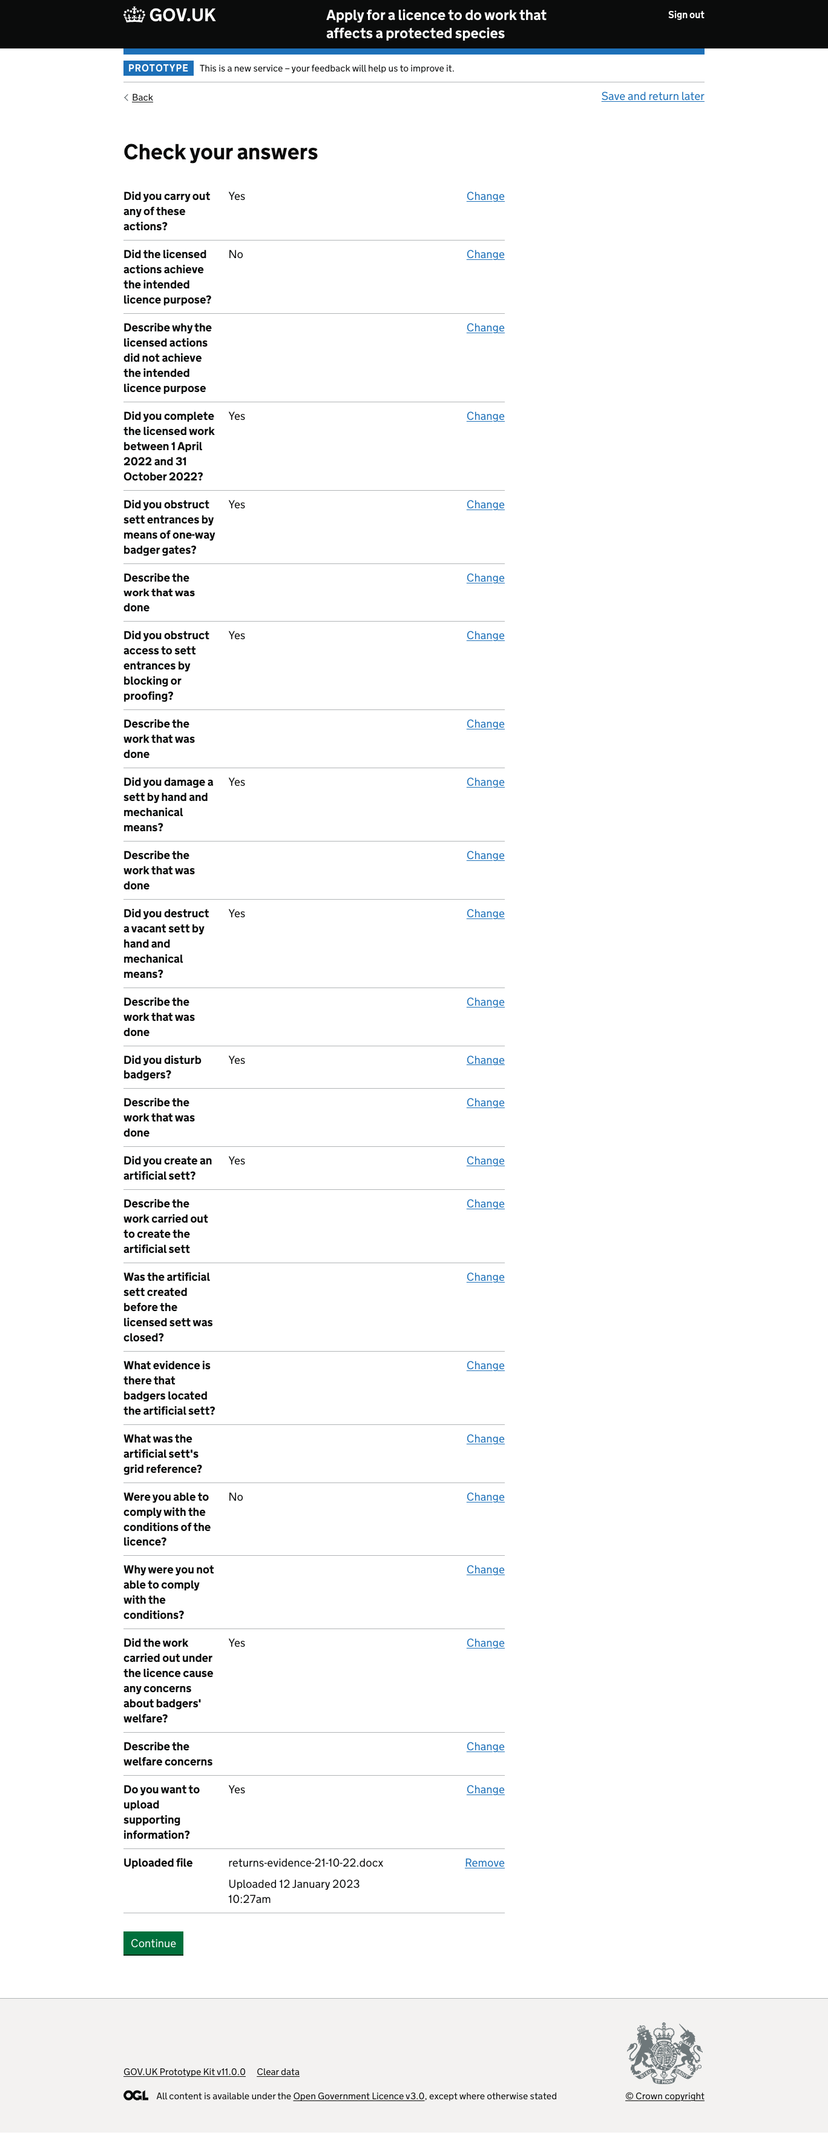
c. Keeping records for auditing purposes
Most participants expressed a desire to have a downloadable copy of the Report of Action form for their records, whether digitally or physically.
They wanted this for quick reference in case of client or Natural England inquiries and as a proof of completion for auditing purposes.
"I would want to be able to print a PDF off for my own archives or save it into a file because I have obviously indemnity insurance and other things so that if somebody then comes back to me and says this person didn't do his job properly and didn't report the licence or whatever, I've got the relevant evidence in there on file." P4

Slide 25
3. Standalone usability issues

Slide 26
Unmet expectations

Slide 27
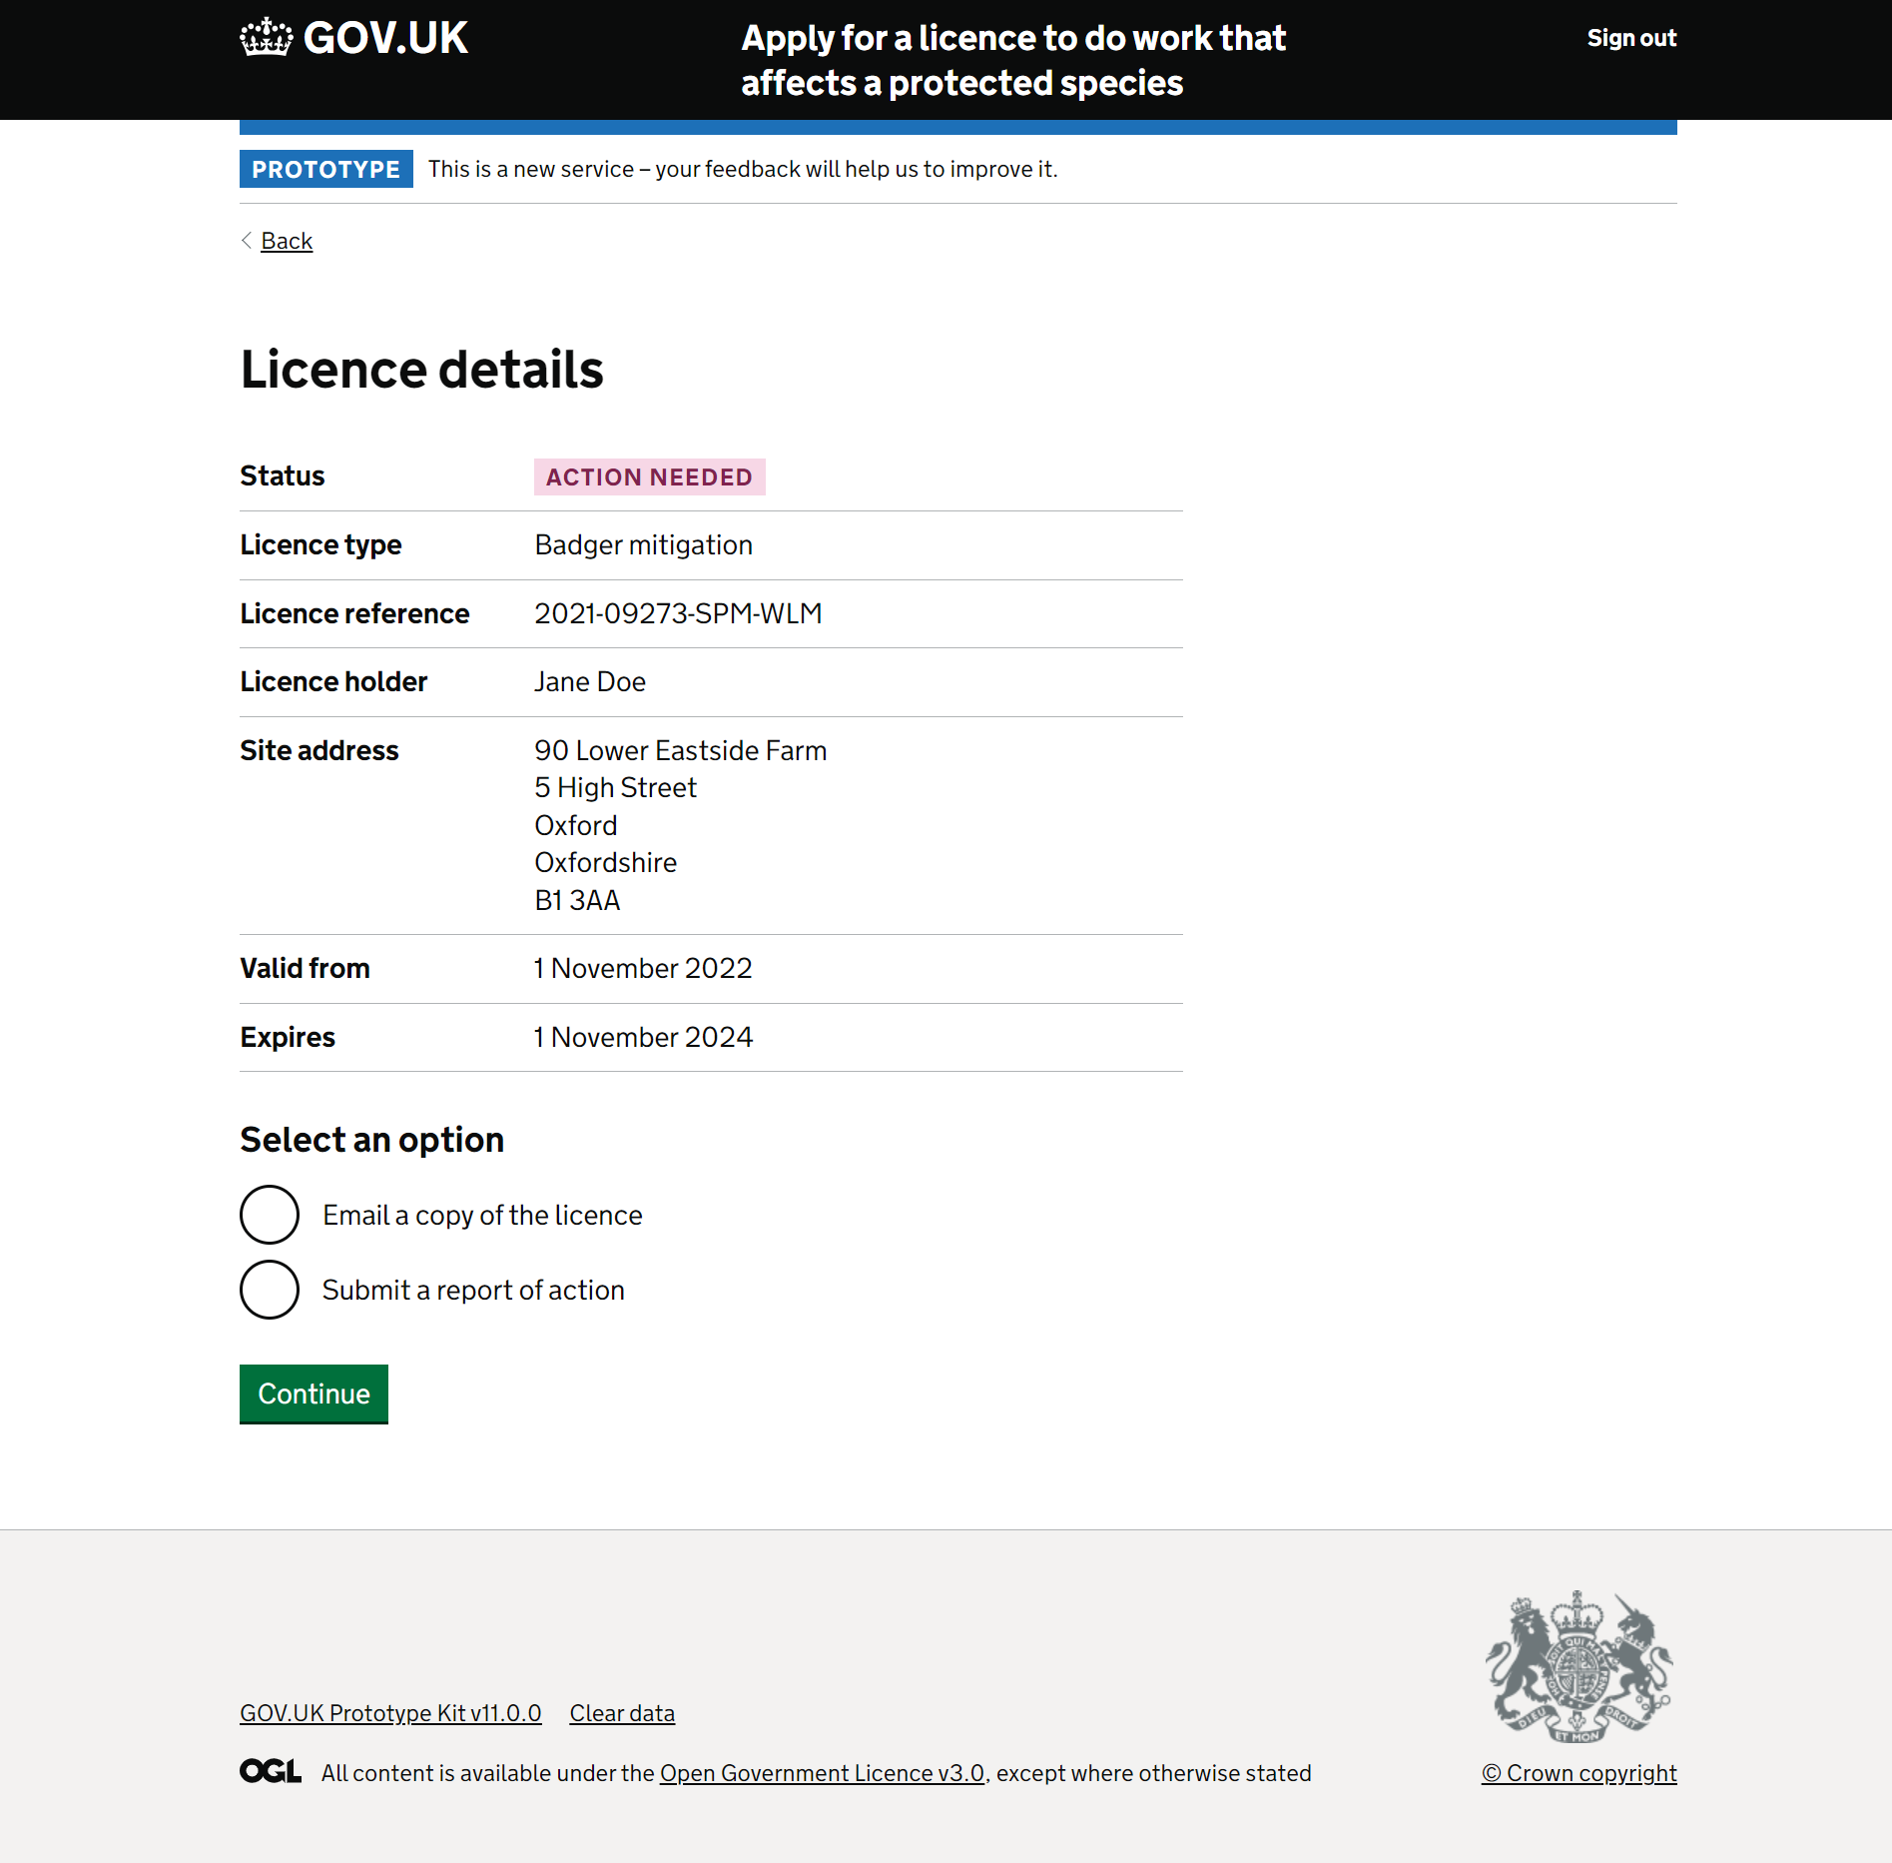
The named ecologist
Participants suggested that in cases where ecologists were part of larger companies with multiple members, displaying the relevant ecologist's name on the license could help ensure appropriate assignment of tasks.
"But there I would assume. Oh, there we are. Actually, I've forgotten to submit my report of action. I shall click on that dot and then continue. But it's not clear. I would rather it have said what action was needed." P4

Slide 28
Performance load

Slide 29
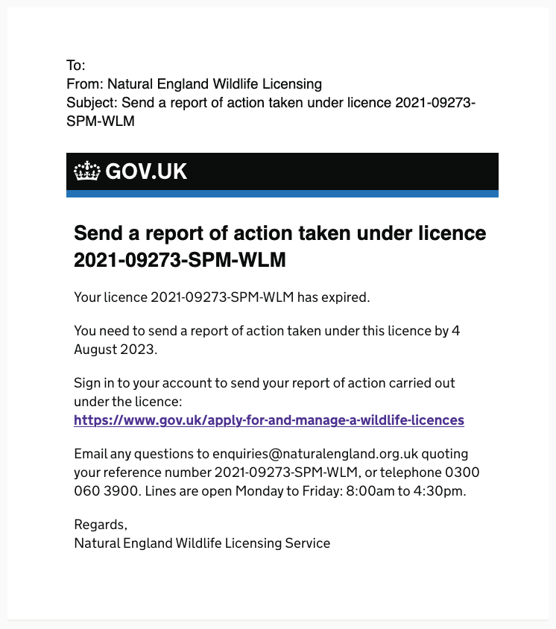
Which licence does it refer to?
The email served as a useful reminder to submit a Report of Action form. However, for users with multiple licenses in various submission stages, it lacked clarity regarding the specific license it referred to, necessitating their own deduction.
"I have no idea what this licence is, no idea what species it is as I can't remember just from the [licence] number" P2
"I would find this frustrating because it's not actually saying click on the link below and as an IT dunce. I would just click on it to see what happened." P4

Slide 30
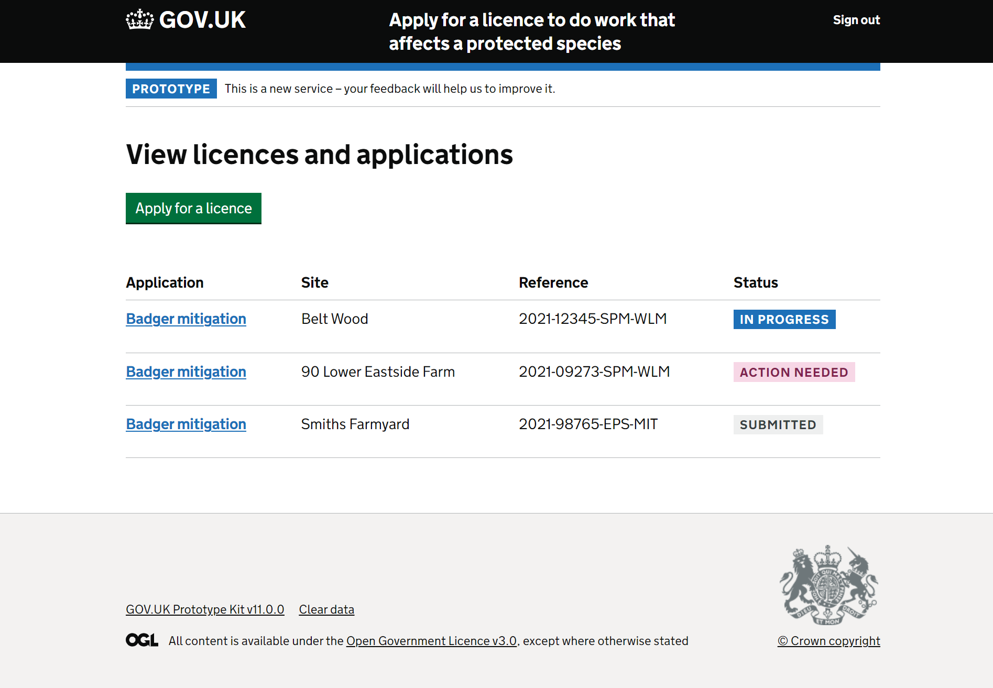
What is the action I need to do?
All participants eventually found the correct 'action needed' option, but with varying effort.
Overall, participants deduced the correct selection through a process of elimination of other options.
This implies that as multiple licenses accumulate with required actions, the performance load required to deduce each licence's stage will increase
"So, I've got one here that says Badger mitigation low at 90. Lower East Side farm. Action needed. I've got one that says in progress. So presumably I'm gonna go to the one that's in progress. I haven't closed it down. That's still live. Haven't got a report on it." P4

Slide 31
What is the action I need to do?
The theme of insufficient specificity persisted on this page. One participant expressed that they needed to correlate a radio option with the status to comprehend the necessary action.
When a clear action wasn't specified, participants commonly reviewed the license dates to guide their required action.
"But there I would assume. Oh, there we are. Actually, I've forgotten to submit my report of action. I shall click on that dot and then continue. But it's not clear. I would rather it have said what action was needed." P4

Slide 32
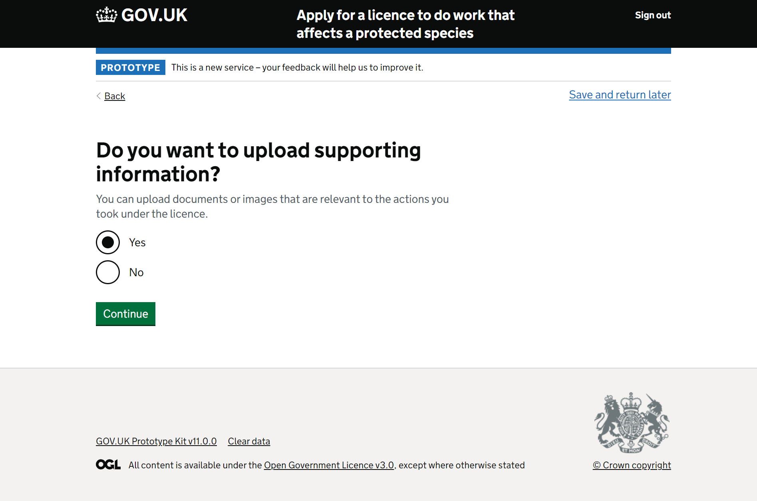
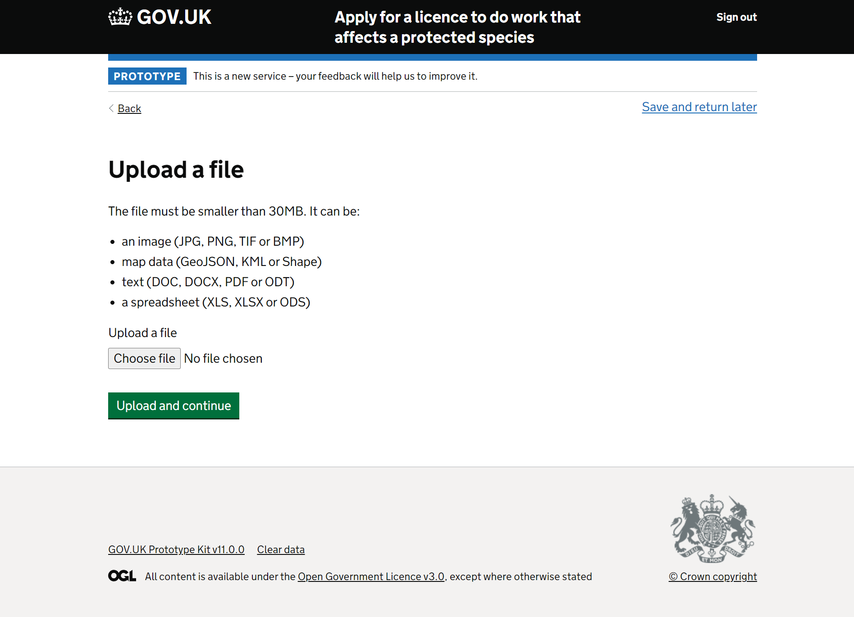
Uploading files – why not do it as you go?
"I think the upload thing should be back at the artificial sett question." P5
Participants found it clear that they could upload various document types such as photos, videos, maps, spreadsheets, and reports. However, some suggested integrating document uploads within the form instead of having a bulk upload feature at the end. This was because they felt they'd otherwise have to move back and forth between pages to remember what they needed to include from earlier in the form.
"Well, I'd rather have it earlier on. Now I've done it. So, I've done it there and then I if I get down here and then it says to me 'do you want to upload supporting information?' I'm now then thinking oh. I've read that earlier. What was it they wanted? I've got a scroll all the way back to find it and then probably print that screen off because by the time I've scrolled forward again to get to here again, I've forgotten what it was that had been asked for. So, I'd rather have it there, yeah." P4

Slide 33
User problems ranked

Slide 34
High impact
User problem | Problem type | Who does it impact | Page(s) of journey | Suggestion
Ecologists are unsure what information Natural England need to assess a submission as efficiently as possible. | Process | All ecologists | 1. did you obstruct sett entrances by means of one-way badger gates? 2. did you obstruct sett entrances by blocking or proofing? 3. did you damage a sett by hand and mechanical means? 4. did you destroy a sett by hand and mechanical means? 5. describe the work carried out to create the artificial sett. 6. was the artificial sett created before the licensed sett was closed? 7. what evidence do you have that badgers found the artificial sett? 9. Did the work carried out under the licence cause any concerns to badgers' welfare? 10. when did you destroy the vacant sett? 11. did you disturb badgers? 12. describe the work carried out to create an artificial sett 13. do you want to upload supporting information? | Secondary analysis of Discovery work and Alpha research with internal users to see if data has been collected to show how assessors assess applications / ROAs, and what needs they have Understand what information users will be required to provide from an assessor perspective. Consider providing this information up front in the journey prior to starting. Decide if we want users to provide a little or a lot of information and clarify to users what they need to provide Decide if we want users to fill out boxes or reference a report they've uploaded - and if the latter, decide how to design this Decide what types of evidence we want users to submit (video, photos, reports, etc.)

Slide 35
High impact
User problem | Problem type | Who does it impact | Page(s) of journey | Suggestion
It's not clear which sett is being referred to at any one time. | Content / Interaction | All ecologists | 1. did you obstruct sett entrances by means of one-way badger gates? 2. did you obstruct sett entrances by blocking or proofing? 3. did you damage a sett by hand and mechanical means? 4. did you destroy a sett by hand and mechanical means? 5. describe the work carried out to create the artificial sett. 6. was the artificial sett created before the licensed sett was closed? 7. what evidence do you have that badgers found the artificial sett? 8. what was the artificial sett's grid reference? 9. Did the work carried out under the licence cause any concerns to badgers' welfare? 10. when did you destroy the vacant sett? | Clarify to users which sett is being referred to at any one time. Understand internally from previous applications the % of licences that have numerous setts and how many Provide functionality to allow users to report on multiple setts.

Slide 36
High impact
User problem | Problem type | Who does it impact | Page(s) of journey | Suggestion
Ecologists currently employ workarounds to ensure transparency for licence holders, allowing licence holders to observe completed forms and understand their legal obligations. | Functionality / Content / interaction | All ecologists | 1. Declaration 2. Start page? | Consider providing a download your form option or Consider an option to email a copy to another party Consider providing information for users at the start of the journey to inform them they will need to sign it, or the licence holder will, so that they do not get to the end only to realise this Consider implementing 'save and return' functionality.
Ecologists keep records of forms sent to NE for audit purposes: so it is easily available within their own records, and to send to others for evidence. | Functionality / Content / Interaction | All ecologists | 1. Check your answers 2. Start page? | Consider providing a download your form option or Consider an option to email a copy to another party Inform users up front that they will be able to obtain a copy for their own records

Slide 37
Medium impact
User problem | Problem type | Who does it impact | Page(s) of journey | Suggestion
Ecologists felt uncomfortable with using a personal government gateway account for business purposes | Process | All ecologists | 1. Government Gateway page | Explore further as part of IDM research
Ecologists are concerned the information provided will be used to monitor and potentially sanction them. | Process / content | All ecologists | 1. did you obstruct sett entrances by blocking or proofing? Potentially all pages where a text box appears. | This may link to making clearer to users why we're asking for certain information. It may also be solved if users are faced with real world examples that show the through-thread between their work and the licence.

Slide 38
Medium impact
User problem | Problem type | Who does it impact | Page(s) of journey | Suggestion
Ecologists mistook the pages 'damage' and 'destroy' as a repetition. Ecologists were also unclear about the distinction between 'damage' and 'destroy,' along with the definition of each being asked about. | Process / Content / (possibly also Interaction) | All ecologists | 1. did you damage a sett by hand and mechanical means? 2. did you destroy a sett by hand and mechanical means? | Highlight the key differences between pages so that it is noticeable for users who will read through quickly. Provide further clarification of the information NE would find useful to help make the assessment and distinction between 'damage' and 'destroy clearer.
Sometimes ecologists destroy setts over multiple days | Content / Interaction | All ecologists | 1. when did you destroy the vacant sett? | Consider providing the option to describe a date range.

Slide 39
Medium impact
User problem | Problem type | Who does it impact | Page(s) of journey | Suggestion
Ecologists were unclear why they were being asked for certain information, given the logic of completing the form provides an obvious answer. 1) Ecologists were unclear why they were being asked whether or not they'd disturbed badgers, given the logic that they will have done if they are completing a Report of Action form. 2) Ecologists were unclear why they were being asked if they complied with all the licence conditions, since they assumed NE would already know about this if not. | Process / Content / Interaction | All ecologists | 1. did you disturb badgers? 2. did you comply with all the licence conditions? | Clarify internally why we are asking this question internally and consider if it is appropriate to ask within this journey or Clarify internally what a definition of disturbance is and provide a definition for users Clarify internally why we are asking if the licence conditions have been met and whether we would know if there have been updates provided since the application. Should these be reflected in the Returns journey?

Slide 40
Medium impact
User problem | Problem type | Who does it impact | Page(s) of journey | Suggestion
Ecologists felt they would need to go back and forth between the upload page and each page where they wanted to upload evidence. And they were concerned they had no way to label each piece of evidence to describe what it was for so that assessors would not get confused. | Process / Content / Interaction | All ecologists | Any page where there was a free text box, but especially where the hint text explained they could upload information. | Provide upload functionality 'in the moment' or Make it consistent across the journey when describing the ability to upload, rather than having it on some pages and not others. Clarify internally what information is 'best' for users to provide for assessors and make this clearer within hint text

Slide 41
Medium impact
User problem | Problem type | Who does it impact | Page(s) of journey | Suggestion
The unpredictability and inherent changing conditions ecologists face with nature makes it difficult for them to present evidence providing certainty and therefore to answer closed questions, especially given the legality implications of being seen to answer inaccurately. | Process / Content | All ecologists | 1. did you comply with all the licence conditions? | Clarify what information NE need and what will be done with it.

Slide 42
Low Impact
User problem | Problem type | Who does it impact | Page(s) of journey | Suggestion
It's not clear which specific licence is being referenced. Ecologists may have simultaneous open licences and tend to (not always) to differentiate between them by the site location. | Content | All ecologists | Email | Include specific reference to the licence (type and/or site it relates to)
The specific action to be taken (complete a Report of Action) is not clear to ecologists without work to understand on their part. | Content | All ecologists | 1. view licences and applications | Include specific reference to the licence (type and/or site it relates to)

Slide 43
Low Impact
User problem | Problem type | Who does it impact | Page(s) of journey | Suggestion
It's not immediately clear who the named ecologist is, which requires effort by ecologists to discover | Content / Interaction | Ecologists working at larger organisations | 1. view licences and applications | Include a reference to the named ecologist
Ecologists' current way of working is to email NE and attach a report. We got an indication from this research that they may continue to do this, entering into fields "see attached report." | Process / Interaction | All ecologists | 1. did you obstruct sett entrances by blocking or proofing? & Potentially all pages where a text box appears. | Decide whether we are okay with users to do this Analyse and evaluate the applications being received through private beta pilot, assessing for quality Research with assessors to understand their experiences of receiving applications through the beta pilot

Slide 44
Low Impact
User problem | Problem type | Who does it impact | Page(s) of journey | Suggestion
Ecologists weren't clear whether the questions related to licenced actions or more general ones. | Content / Interaction | All ecologists | Potentially all pages. | This may be solved with a working example, rather than interactive prototype.
Ecologists were unsure if certain types of evidence was or was not required when hint text suggested they could upload information. They were not sure if it was optional or required. | Process / Content | All ecologists | Any page where there was a free text box, but especially where the hint text explained they could upload information. | Make it clear to users what information they need to provide that is optional and what is required.

Slide 45
Low Impact
User problem | Problem type | Who does it impact | Page(s) of journey | Suggestion
Ecologists felt the 6 digit reference code would not be useful | Process / Content | All ecologists | 1. what was the artificial sett's grid reference? | Clarify how this information will be used and consider whether 6 digits is useful enough.
Ecologists aren't clear if it's the named ecologist or someone else who can sign the form, nor what happens if the named ecologist can't. | Process / Content / Interaction | All ecologists | 1. declaration | Review internally what happens if a named ecologist cannot sign the declaration and consider if this is appropriate or not to replicate

Slide 46
Summary
There are significant usability and user experience problems with the current Returns journey
Some are high impact to the user and, if not fixed, would create extreme difficultly for users' current way of working
Ecologists need more understanding of how ROAs are assessed so that they can collect the right data in the first place and ensure quality submissions
The journey needs to be redesigned to include multiple setts
Some quick fixes can be made, although these are in the medium to low impact to the user categories

Slide 47
Suggestions / What next
Research with assessors to understand how they make assessments and what they need
And/or workshop with NE stakeholders to better understand the purpose behind questions and combine with needs of assessors to decide how to present these to users
Define and decide MVP ahead of public Beta release
Integrate decisions into design iterations
+ Exploratory research to create a richer picture of user needs / journeys:
Dedicated research on how ecologists work with clients and apply for applications
Dedicated research with a range of ecologists (including those working with farmers, etc.)
Analysis of current ROAs submitted through beta pilot (if any)
Dedicated research with licence holders to understand their needs of the ROA submission

Slide 48
Appendix

Slide 49
Findings from usability testing of the Report of Action online form

Slide 50
The email is useful, but not specific enough
L
The email served as a useful reminder to submit a Report of Action form. However, for users with multiple licenses in various submission stages, it lacked clarity regarding the specific license it referred to, necessitating their own deduction.
Moreover, one participant, who was less confident with digital skills, explicitly desired clear instruction to click the link, eliminating uncertainty about the correct action.
"I have no idea what this licence is, no idea what species it is as I can't remember just from the [licence] number" P2
"I would find this frustrating because it's not actually saying click on the link below and as an IT dunce. I would just click on it to see what happened." P4

Slide 51
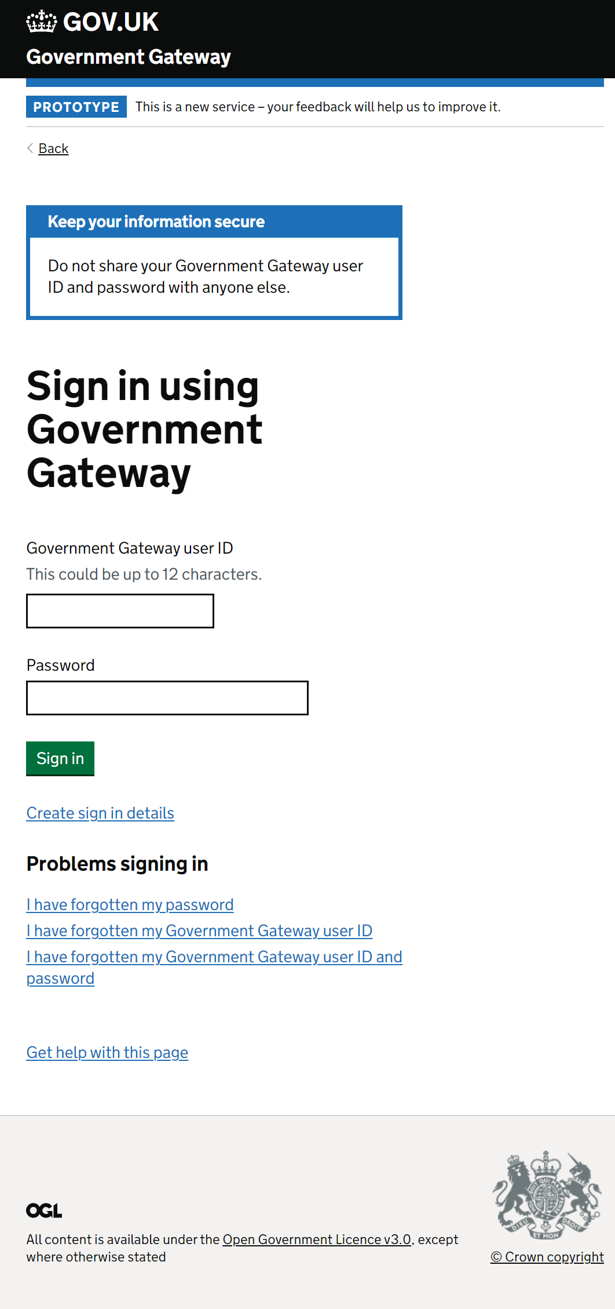
Participants felt uneasy about the prospect of using a personal Gov Gateway account
Participants, though familiar with Government Gateway, felt uneasy about using the prospect of using a personal account for business, since they were unsure about what information would be linked.

Slide 52
The 'view licences' page was understood, but was not specific enough
L
The 'view licences' page was universally understood and seemed to potentially serve as a central hub for all license applications. And Participants primarily used the site name to search for their intended license.
All participants eventually found the correct 'action needed' option, but with varying effort.
Overall, participants deduced the correct selection through a process of elimination of other options.
This implies that as multiple licenses accumulate with required actions, it might become cognitively demanding to deduce each licence's stage.
"So, I've got one here that says Badger mitigation low at 90. Lower East Side farm. Action needed. I've got one that says in progress. So presumably I'm gonna go to the one that's in progress. I haven't closed it down. That's still live. Haven't got a report on it." P4

Slide 53
Although understood, lack of specificity increased participant effort on this page.
L
The theme of insufficient specificity persisted on this page. One participant expressed that they needed to correlate a radio option with the status to comprehend the necessary action.
When a clear action wasn't specified, participants commonly reviewed the license dates to guide their required action.
Furthermore, participants suggested that in cases where ecologists were part of larger companies with multiple members, displaying the relevant ecologist's name on the license could help ensure appropriate assignment of tasks.
"But there I would assume. Oh, there we are. Actually, I've forgotten to submit my report of action. I shall click on that dot and then continue. But it's not clear. I would rather it have said what action was needed." P4

Slide 54
Yes/no? What about maybe?
M
Every participant comprehended the 'nil report of action' option.
During the testing, it became evident that ecologists often faced ambiguity and encountered grey areas in their work.
At times, the 'yes' and 'no' options were clear, but participants felt they fell short when partial actions occurred under these choices without completing them entirely.
"There's no partial action for destroying part of a sett, not all of a sett but I suppose that's covered by damaging the sett not destroying all of it... There's no option for partial destruction... It's clearly a bit ambiguous, or I'm a bit thick." P1

Slide 55
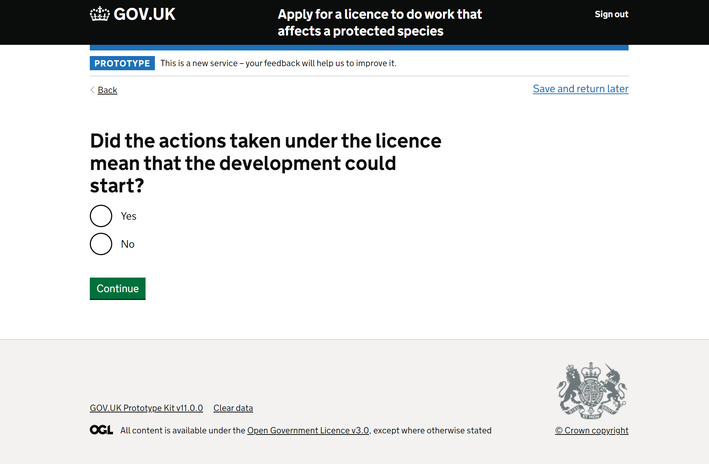
The purpose of the question was unclear
M
While participants grasped the question, its underlying intent remained unclear. One participant was uncertain about how it contributed to assessing license returns, assuming it was solely for data collection.
Furthermore, another participant (P2) highlighted the inherent variability in development work and wildlife ecology. They envisioned a scenario where badger-related tasks might be carried out, yet they might select 'no' if the development work hadn't commenced immediately. This example raised doubts about the question's essence and its literal phrasing.
"Oh, yes, yeah, fine. So, the action meant the development could start. Yes, they did." P4
"I'm not sure how that question helps the licence returns? Is that for data purposes?" P2

Slide 56
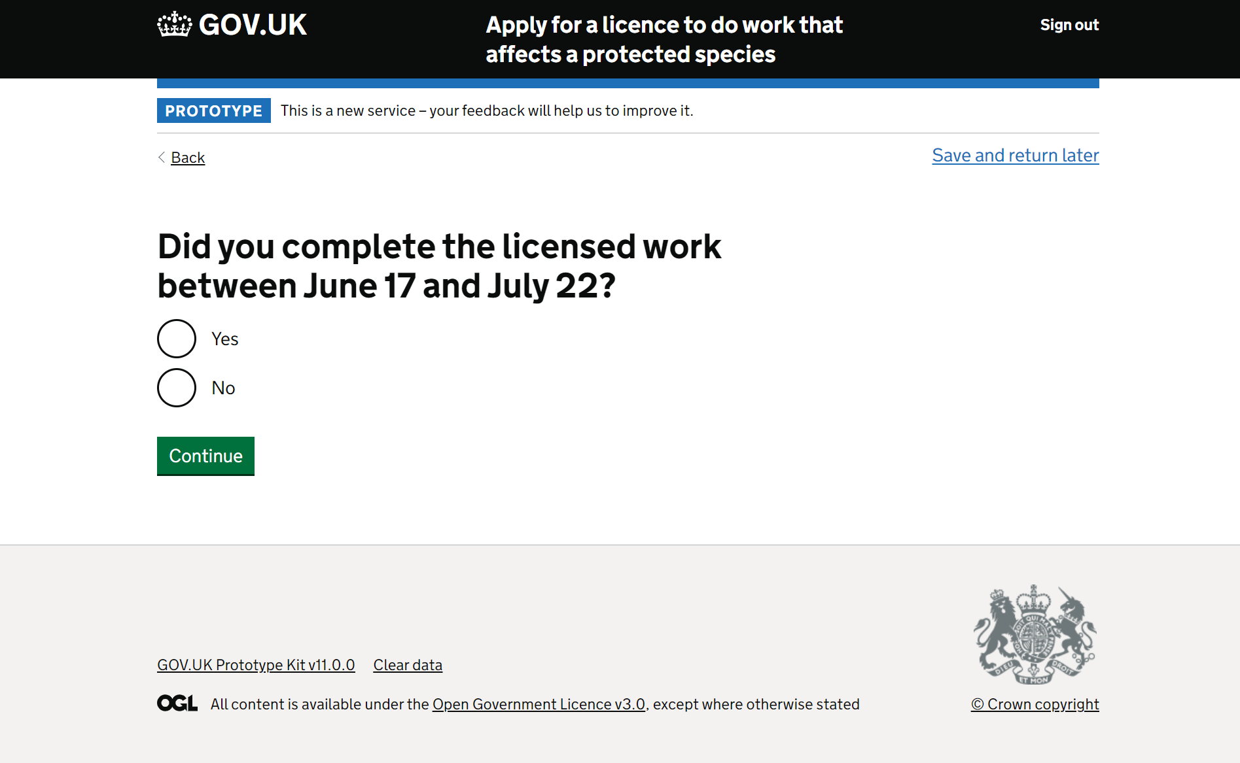
This page was understood
Participants comprehended this page, and for badger licences, they noted inaccuracies in the prototype's dates. For instance, closing badger setts wouldn't be permitted in June.

Slide 57
Participants felt suspicious of the question and were afraid of giving too much away.
M
The purpose behind the question and the required information to include were not entirely evident to participants.
This initiated a recurring theme where participants aimed to strike a balance in sharing information with NE to provide enough for utility but avoiding excess that might prompt NE to question their actions or raise legal challenges.
Participants were concerned about scrutiny, challenges, possible sanctions and delay in receiving a licence.
"What are they wanting me to describe?... I want to be honest, but I don't want to someone to come back and question the variations." P3

Slide 58

Some participants realised here that they were completing a chunked up A24 form.
Initially, when participants began interacting with the prototype, they anticipated it would work much like their current method – downloading a form and emailing it with evidence attached.
However, it was during this phase that participants began recognising that they were, in fact, completing a segmented A24 form directly online.
Subsequently, concerns arose regarding the space allocated for responses. While most participants sought to minimise the information they provided to avoid potential follow-up inquiries from Natural England, one participant expressed a desire to offer substantial details.
"Oh, I see, I'm almost producing a report but in little blocks... how many words or lines is it going to let me write? "I want to go into a lot of detail but it sometimes it won't let you" P1

Slide 59
Will we see users simply upload reports?
?
Several participants mentioned that they would adapt the situation to align with their usual workflow by attaching their field report (which they create after completing the work) to the form.
One participant went so far as to enter "see attached report" in the free text box with the presumption they would upload their report later.

Slide 60
Is this in the licence or not?
L
One participant felt the link between the methods asked about in the question and those sanctioned in the licence should be made clearer to avoid confusion. To them, the question felt like it lacked context – is it here because it is related to what was sanctioned in the licence or is it a general question?
"Um, why is he asking me this question? So, I think you'd need to come up with something saying, for example, 'the set was to be destroyed.' Yeah, which, yeah, I think I'd give a little bit more information, because now I'm wondering, was I supposed to do that?... So, be clear about why it's asking this question - i.e. [was] it was in the licence and you want to know did you do this licenced activity?... [because] you have the licence, specifically [with] conditions, [and] you are obligated to implement the licence exactly as set out." P4

Slide 61
Will I be monitored?
M
The recurring theme of participants feeling that they are being monitored arose here once more, with participants unsure as to why the question is otherwise being asked.
The reason for that worry emerged later as participants began elucidating the other big recrurring theme that was about the difficulty in providing certainty when presenting evidence.

Slide 62
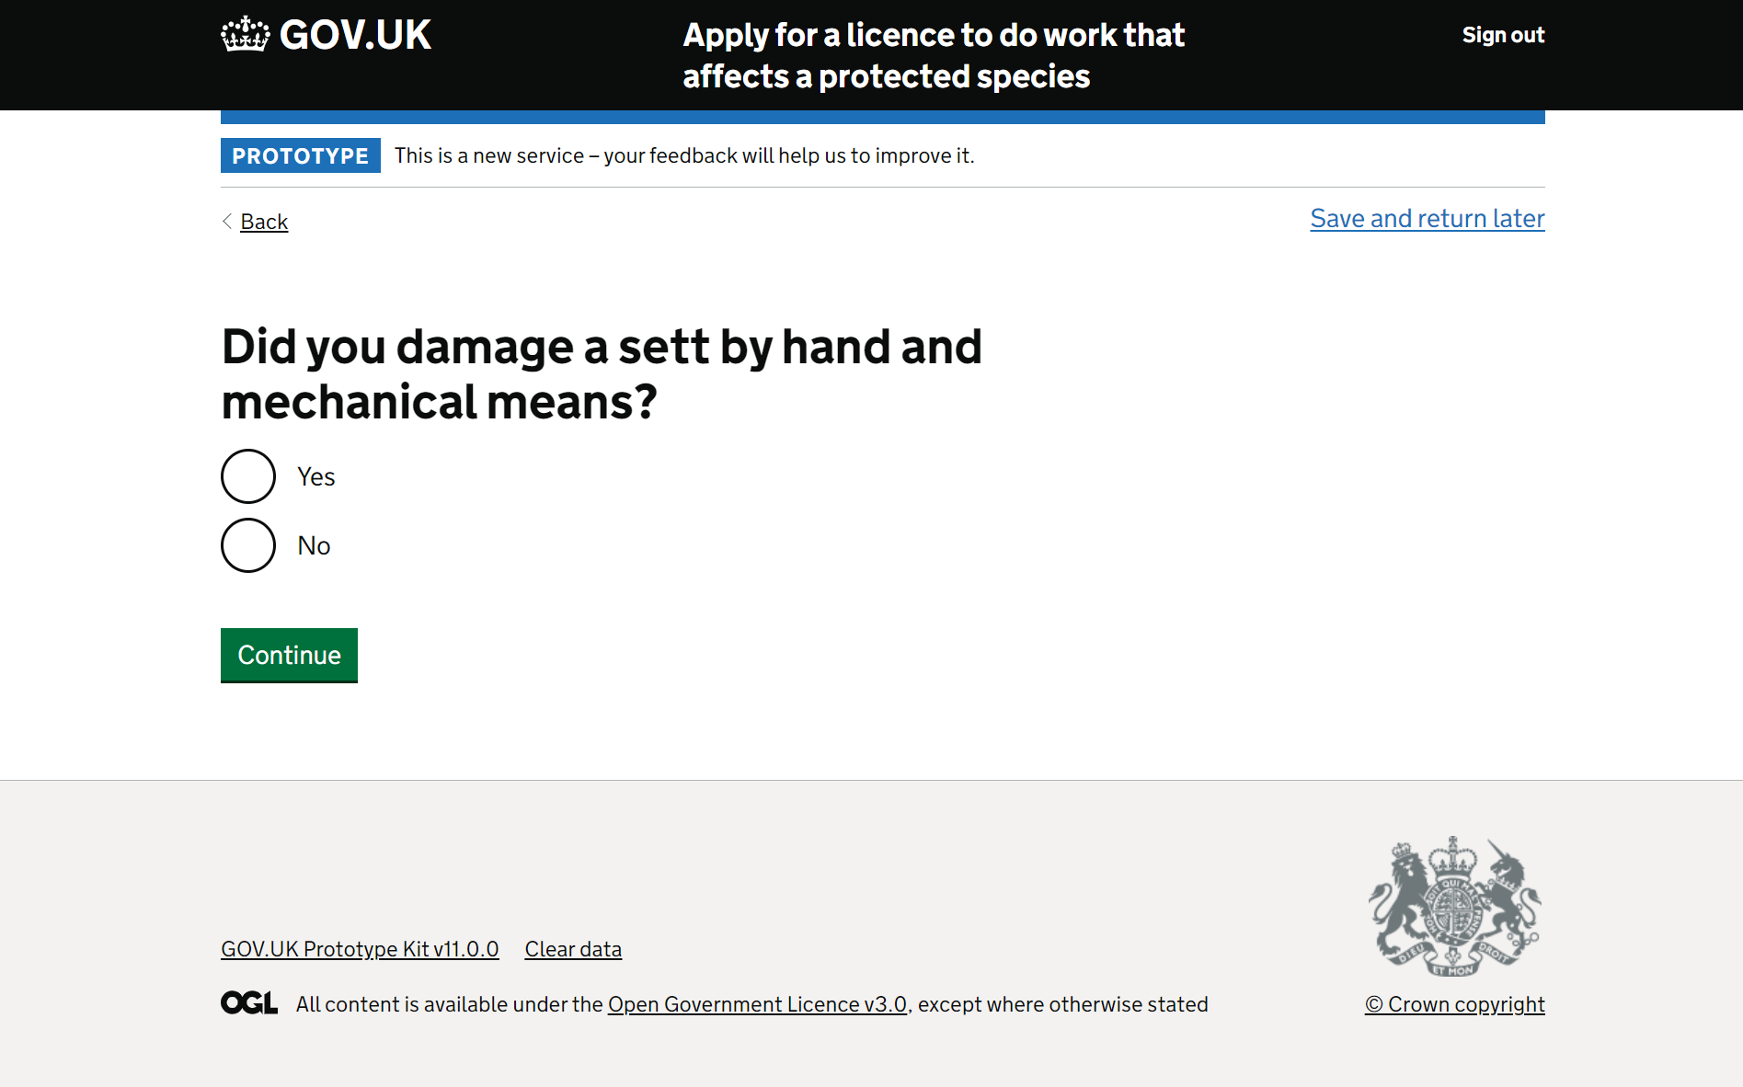
Is that enough information?
M
In repeat of a recurring theme, one participant (P5) struggled to know how much information to include here to ensure it was "enough."

Slide 63
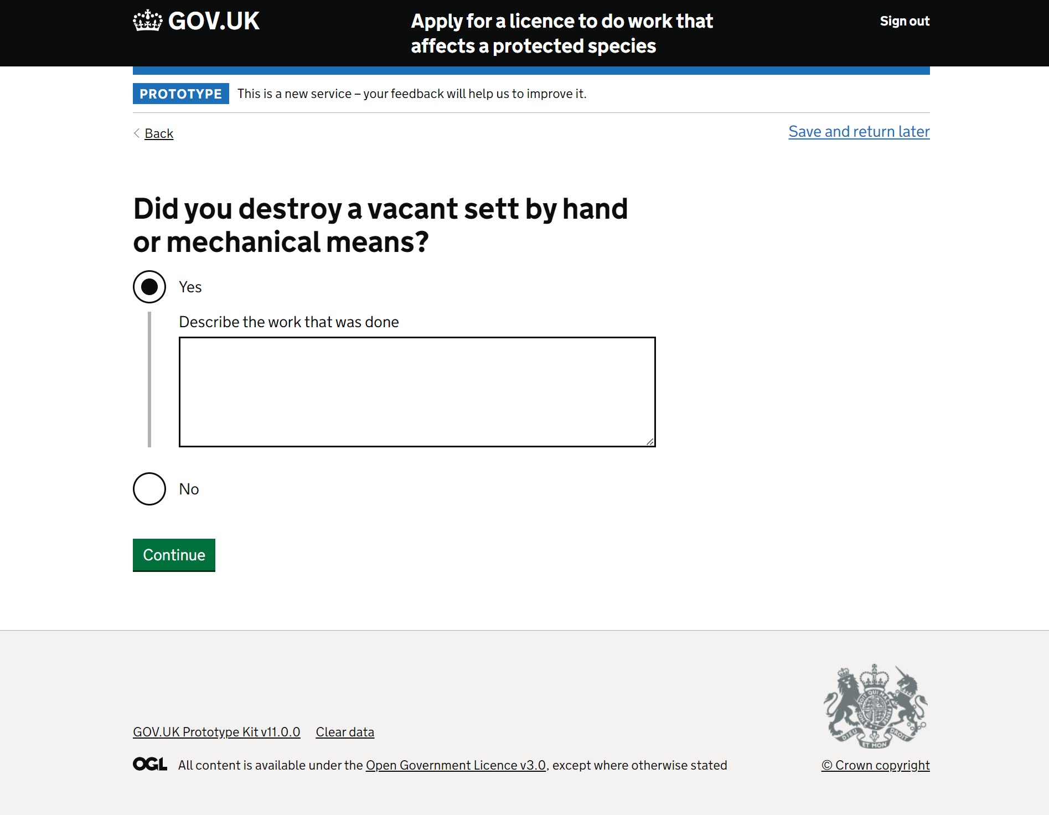
Damage vs destroy
M
Initially, participants mistook the page for a repetition, overlooking the contrast between 'damage' and 'destroy.' They frequently had to backtrack between the pages to discern the discrepancy.
Once aware of the distinction, participants could articulate the contrast between 'damage' and 'destroy,' realising their reference to licensed activities.
However, the clarity of each term seemed uncertain, evidenced when ecologists tested them with various hypothetical scenarios.
This indicates that comprehending and distinguishing the terms demanded cognitive effort, though participants ultimately grasped them accurately.

Slide 64
Which sett does this refer to?
H
A participant highlighted the issue of multiple setts falling under the license for damage or destruction. The form lacks specificity on which sett is being referred to, causing confusion.
"It doesn't refer to multiple setts." P3
"They'd be in different situations. So, you can have one licence that covers you for many setts. You might be damaging one annex set or distraught and destroying several outlier sets. Said that, the annex set will be damaged, but the Badgers are gonna redig it within you know, week." P4

Slide 65
What if it's across multiple days? And which sett do you mean?
H
While all participants understood this question, multiple explained they've had situations previously where they've closed a sett over multiple days, meaning that the single day input field is inadequate.
Moreover, multiple participants raised the concern of dealing with multiple setts under a single license, prompting the question: "which sett is this referring to?"
"Some setts take more than a day to destroy." P2
"So, you'd want to get some dates that that work were done, so set one this date set two this date set three. This date range. Do you see what I mean?... It would have to tie in exactly with the licence, wouldn't it? So, in the licence you have named the sets you have said this is set A. This is set B. This is set C or 1234, so, this form would have to anticipate each set and its number in the licence so [that] it says set 1one in your method statement, set two in your method statement." P4

Slide 66
What do you need from me to be satisfied the sett was vacant?
M
One participant questioned how they could evidence a sett was vacant with enough certainty to satisfy NE's requirements.
"That's how I do it. What you want to happen is that there are badges in the set. Because if there aren't badges in the sett, then you've never really sure that there definitely aren't badges in the sett and they haven't got some other way in and out. So, you want your sand traps to show initial activity all going one way because once the gates are set to one way, hopefully the badgers are just going out and you shouldn't have any paw prints going back in. So after about four days you hope that... more or less activities have wound down, they've all left and then you're confident. But the thing is that, is the set is actually empty?" P4

Slide 67
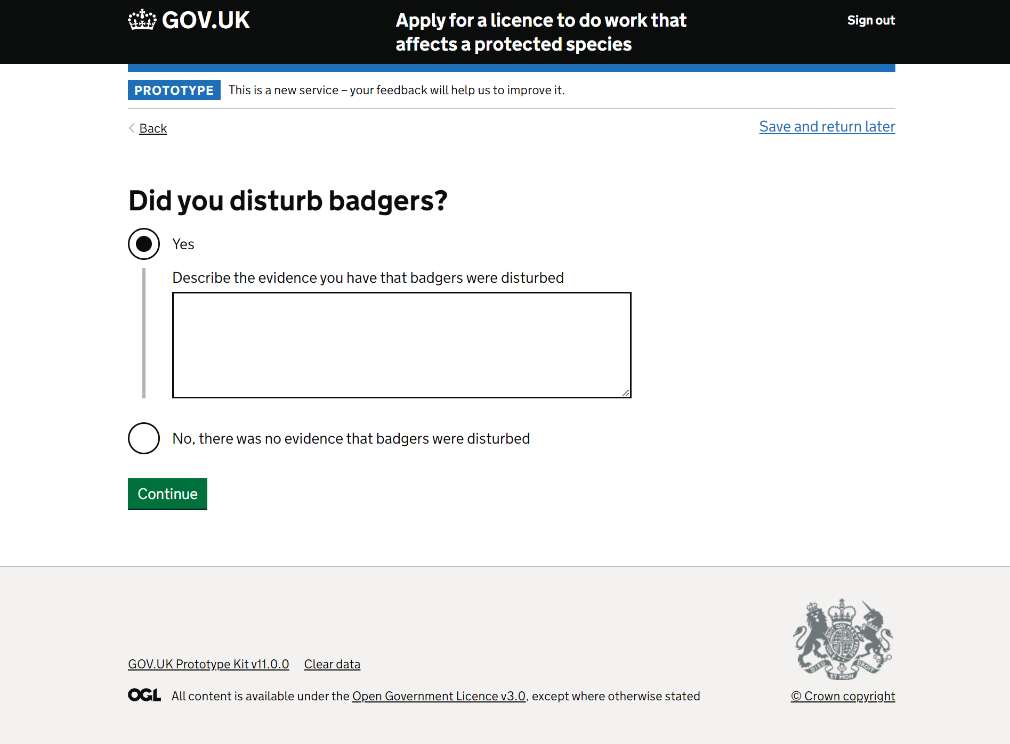
Obviously, I have disturbed badgers, right ?
M
Initially, participants grasped this question, but upon reflection, confusion arose about its relevance and meaning.
They couldn't envision a situation where a badger license would be required other than for badger disturbance, unless it was to report zero action taken.
In which case, they were perplexed about reaching this stage in the Returns process.
"You can't really close a sett without disturbing them.
Might be a silly question?" P2
"It's irrelevant. The fact that you've had a licence means that you definitely know [there are badgers]. And if you were excluding badgers... I've just said [in a previous page] that I've destroyed a set." P4

Slide 68
Disturbance – is it about distance or something else?
M
Upon deeper consideration, some participants raised a query regarding the interpretation of 'disturbance' in the question. They questioned considering it in relation to the legally defined distance from a sett where development work occurs.
"I take that as anything within 30m has the potential to disturb badgers [the distance used in Scotland]" P5
"Ohh here's here's a good one for you. I had to give advice to a friend who was working for a telecoms company. They had to put up a large one of these large mobile phone masts and they've got to the site and found that they had a main badger sett. He measured it and he said that they're definitely here. But, we're not digging them up. We're building in the field next to them, but we're gonna be about 10 metres away from that sett. I said that's slightly breaching legislation, isn't it, no? I said, well, it all depends on the context of the sett. But we decided that yes, as they were going to be building a compound and that this was going to mean that the badgers had to take an alternative route to and from this set. They would be a disturbance." P4

Slide 69
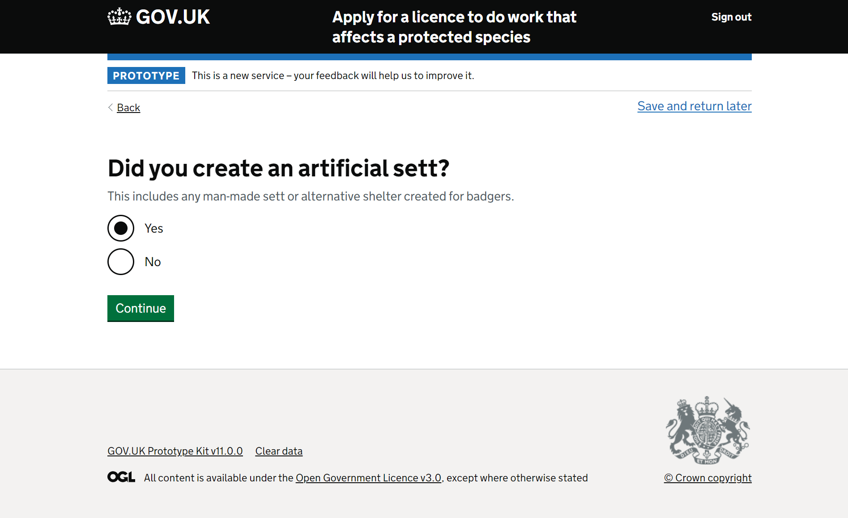
Participants all understood this page and there were no issues.

Slide 70
How much information do you need?
M
While generally understood, participants were not clear how much and what detail was necessary to include on this page
One participant expected to be able to upload the documents they wanted to at this point.
""There's not a clear picture of what's wanted or needed" P2

Slide 71
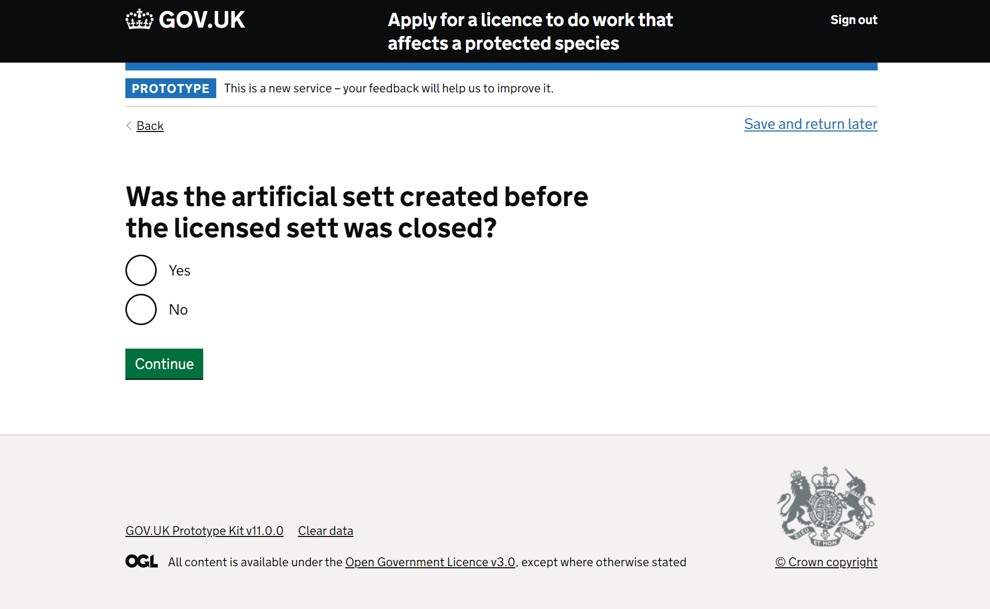
Why do you need this? what will be done with it? and so, what should I provide?
M
The question's clarity seemed evident.
However, uncertainty emerged about the purpose and handling of this information for one participant.
What details are needed? How is assessment and monitoring conducted? Is it a mere checkbox or more involved?
This led participants to question what they should provide.

Slide 72

What evidence is sufficient?
L
In a recurrent theme, the question's clarity seemed evident.
However, uncertainty emerged about whether the hint text meant that evidence was required or optional.
This gave rise to one ecologist feeling that anything optional should be indicated during licencing so that appropriate data can be collected as the work is carried out. It would be too late to introduce it at this stage.
This once more provoked multiple participants to question: what evidence should I provide?
"I think you need to let people know that in the licence. So, I think what you'd have to do is in the licence, when it was issued, you would have to make it clear to them the data that they needed to collect. How are they going to collect that monitoring data? Yes, absolutely. You're gonna need this to be able to complete this return." P4

Slide 73
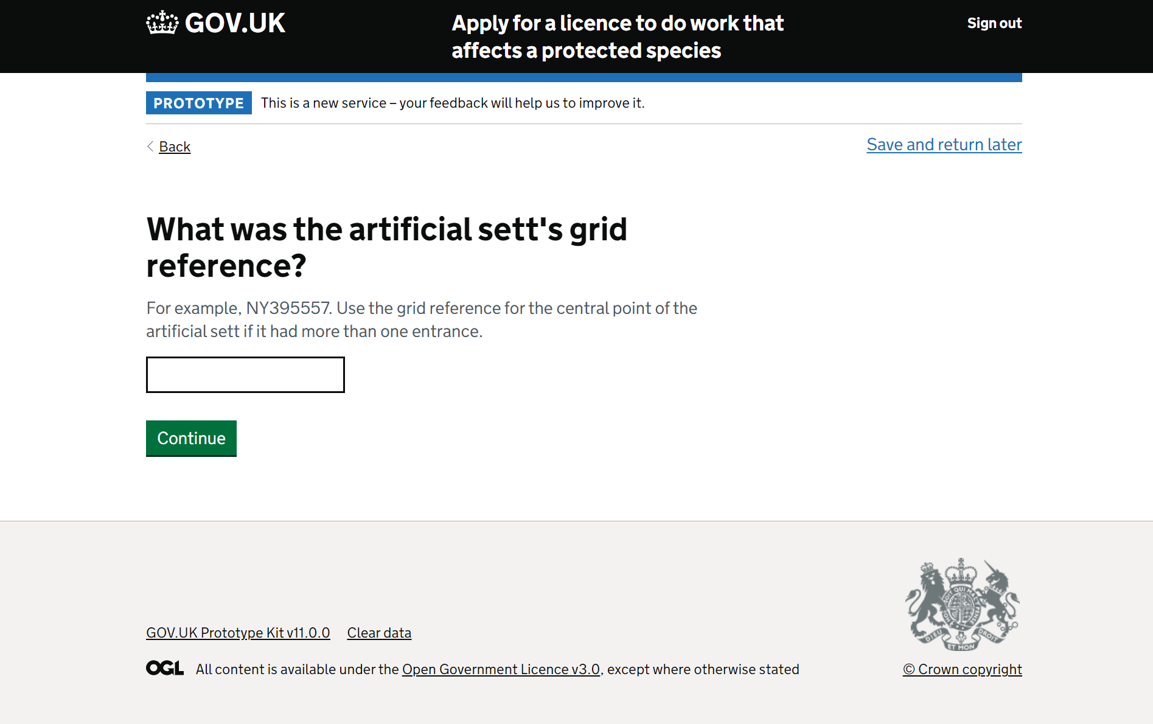
Participants understood this, although tend to use other location references
L
While participants all understood this, most participants spoke about using What3Words or other forms of coordinates rather than grid references for their specificity and ease of use.
Additionally, one participant (P3) questioned whether a 6-point grid reference would be specific enough to help someone locate an artificial sett.
And some participants questioned the purpose of including this question at all, since they felt it was information that could be retrieved from the licence application.
.
"We still use grid references but they're not as usable anymore... We use What3Words or Google pins." P4

Slide 74
If this was 'no,' NE would already know. So why include this question here?
Participants comprehended the literal meaning of the question, but they questioned its relevance.
Some indicated that the information should already be available to NE through the licence application, and that they would have communicated any updates to NE in the meantime.
"It's a bit late to be reporting issues to NE at this point." P2

Slide 75
What would happen if I selected 'no'?
M
One participant highlighted minor variables that, while logical, could shift an answer from 'yes' to 'no,' potentially raising concerns. They believed they could provide further details in the free text box but felt uncertain and anxious because they weren't sure about the consequences of making changes that didn't precisely align with the license but still achieved the same result.
"Well, as I say, where were you able to [vs] did you? You said [in the licence application] that you were going to use a 1-metre wide and half a metre deep digger bucket with no teeth to excavate the soils. But having got down a metre you found that there was a large lump of concrete there, which meant that you needed to change the digger bucket to a toothed bucket to be able to lift the blasted thing or get some sort of strop under it and lift it up with a different machine." P2

Slide 76
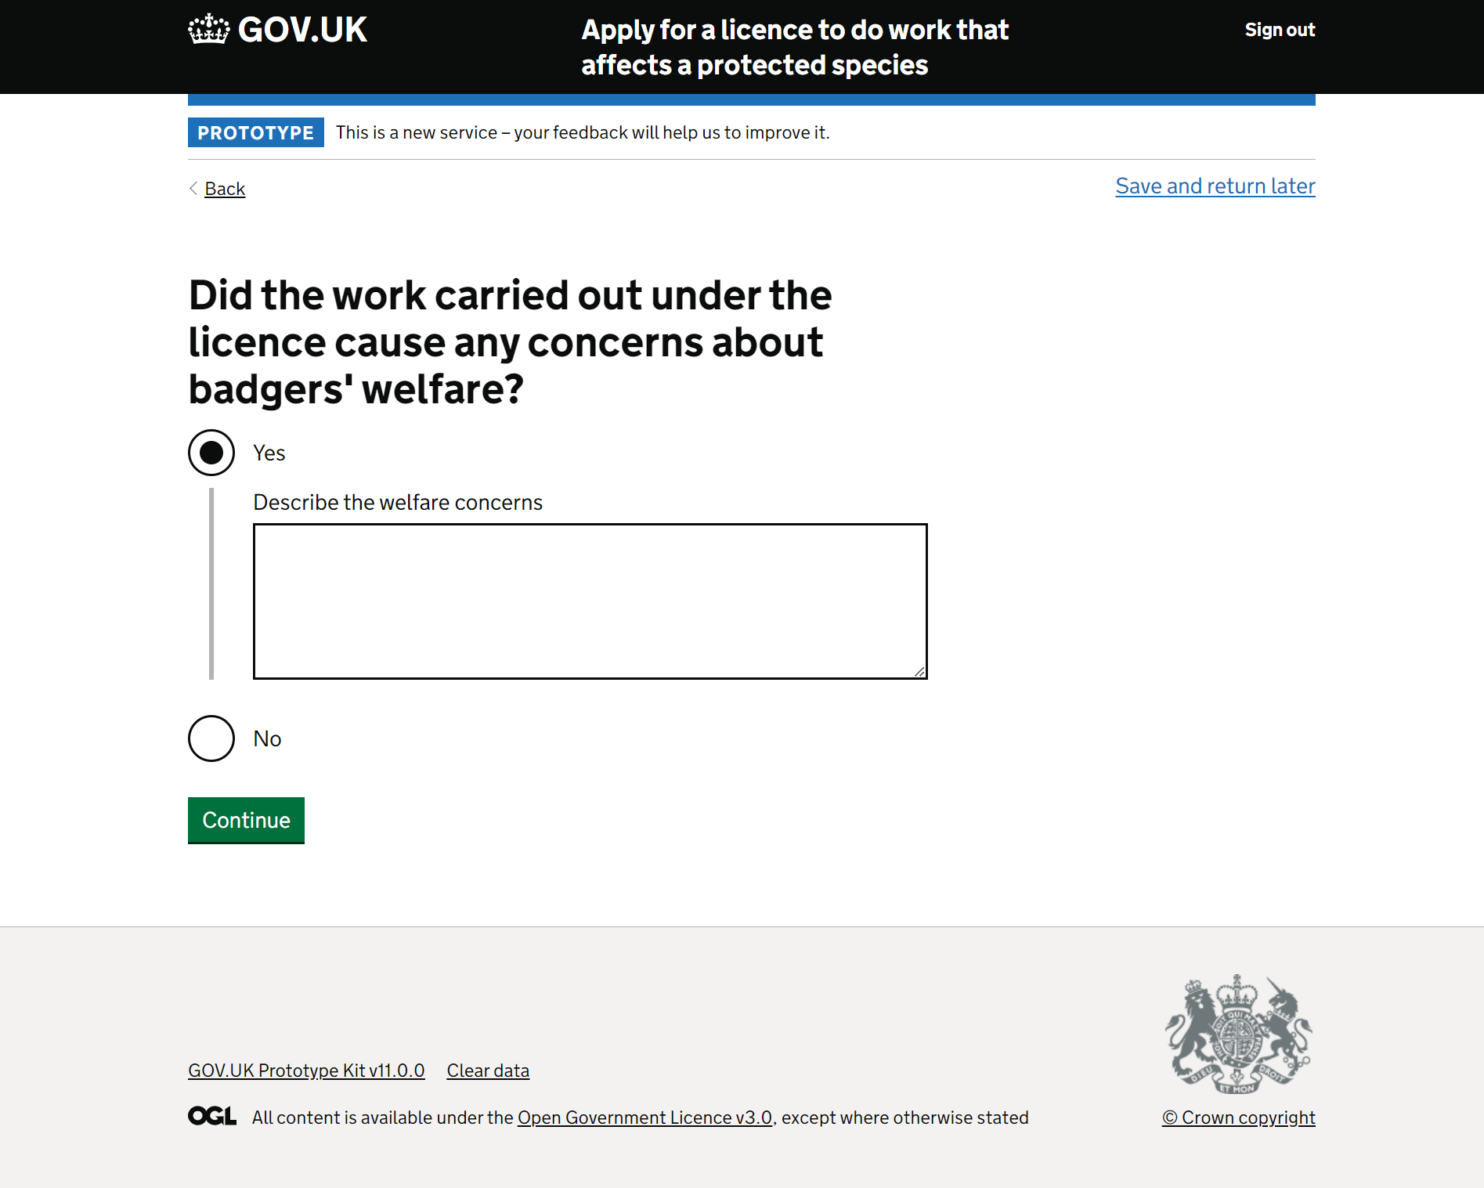
This page was understood.
Participants all understood this page and were able to answer without problem.

Slide 77
Uploading files – why not do it as you go?
M
"I think the upload thing should be back at the artificial sett question." P5
Participants found it clear that they could upload various document types such as photos, videos, maps, spreadsheets, and reports. However, some suggested integrating document uploads within the form instead of having a bulk upload feature at the end. This was because they felt they'd otherwise have to move back and forth between pages to remember what they needed to include from earlier in the form.
"Well, I'd rather have it earlier on. Now I've done it. So, I've done it there and then I if I get down here and then it says to me 'do you want to upload supporting information?' I'm now then thinking oh. I've read that earlier. What was it they wanted? I've got a scroll all the way back to find it and then probably print that screen off because by the time I've scrolled forward again to get to here again, I've forgotten what it was that had been asked for. So, I'd rather have it there, yeah." P4

Slide 78
Uploading files – why not do it as you go?
Additionally, some participants questioned how Natural England would be able to match each document to the question it is supposed to correlate to / supply evidence for if everything was uploaded at the end without the ability to assign a label.
"How would Natural England know what you are trying to show with each file?" P5

Slide 79
What do you need me to upload?
M
"It needs to be more prescriptive. I don't have to give them and I won't upload any. It needs to be [clear if it's] a requirement or not." P3
Some participants suggested that it would be more helpful to specify the required evidence or what would be useful to Natural England, rather than giving them the choice to upload documents. This would reduce the cognitive load on ecologists, as they wouldn't need to guess what NE might need.
"Do you want to upload supporting information? Well, you need to, so yes. Yes. That said, do you want to upload supporting information? Well, no, I don't. I'd rather go and play Star Wars Battlefront on the Xbox. If you have to – I think that needs to be worded slightly differently, but that's just me being pedantic?" P4

Slide 80
Great – but can I get a copy?
H
Most participants expressed a desire to have a downloadable copy of the Report of Action form for their records, whether digitally or physically. They wanted this for quick reference in case of client or Natural England inquiries and as a proof of completion for auditing purposes.
"I would want to be able to print a PDF off for my own archives or save it into a file because I have obviously indemnity insurance and other things so that if somebody then comes back to me and says this person didn't do his job properly and didn't report the licence or whatever, I've got the relevant evidence in there on file. So, I would like that as a PDF with all the information that I submitted so that I could then file that and say, 'right, that's that done.' [I can] file it away. [I] don't need to think about it anymore." P4

Slide 81
Participants understood this but raised (sometimes) serious concerns
Participants quickly reviewed this page and grasped its main purpose: for an authorised individual to confirm the accuracy of the provided information, with the option for either the ecologist or the license holder to make the declaration. However, it raised several questions and concerns

Slide 82
Does 'the ecologist' legally need be the named ecologist on the licence?
L
One participant was unsure if the ecologist making the declaration had to be the named ecologist on the license or if another ecologist, such as a junior.
While it did not arise during this research, this also raises the question of whether a substitute ecologist is acceptable and how that could be handled within the design, for cases such as illness or staff turnover.
"But there's an issue there, isn't there? Because that's all data [[evidence] being collected]. So, one wonders about the legality of that, and I don't know. I wouldn't be qualified to answer that. But you can have somebody who's an employee and relatively low down the food chain filling out one of these... "I think you'd need either the ecologist the licence was issued to – the Principal Ecologist on the licence – or the licence holder." P4

Slide 83
Some (not all) ecologists send the current L24 form to their client for 'sign off.'
H
Some ecologists currently have a process where they complete the form and send it to the client for their signature as the license holder before submitting it to NE. Others, like P4, communicate with their clients closely and get their input. Ecologists do this for transparency, ensuring license holders understand their responsibilities, and would feel otherwise uncomfortable.
However, P2 when faced with this page, highlighted a challenge with license holders being directors of large companies, potentially unavailable for immediate submission. In summary, this page's functionality wasn't as expected and posed an insurmountable barrier for P2.
"At that point, I would not submit [without the licence holder having viewed and sanctioned the form]." P2

Slide 84
Other ways ecologists provide transparency for their clients (licence holders)
Participants assumed developers would be the license holders during testing. Ecologists spoke of different ways they provide transparency for their clients as licence holders as part of submitting legally binding forms on their behalf.
1
Have them to sign off before submitting
2
Call and have them verbally confirm before submitting
3
Submit and send to them to ratify

Slide 85
Inspiration for providing transparency from ecologists
When faced with a new, more restrictive, process that would break their existing workaround solutions, participants suggested different solutions.
"An opportunity to download what you've entered and then send that to the licence holder." P2
Note: these are solution suggestions for consideration and inspiration only. We may discovery an even smarter way of solving this problem.
1
Open access to licence holders to complete
2
Complete, then share a copy of the form prior to submitting
3
Submit and send to them to ratify
"Does it need a double tick" P3

Slide 86
All the way to then end and then start again?
H
Although participants didn't mention it during research, a consequence of not being able to submit at the end is the potential need to start over unless they can save their work.
"At that point, I would not submit [without the licence holder having viewed and sanctioned the form]." P2

Slide 87
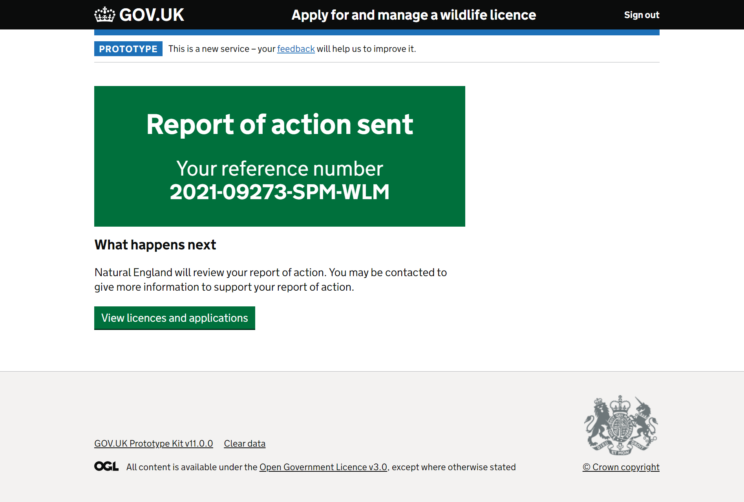
Great, but will the licence close?
L
Participants understood that this page confirmed successful report of action submission and that Natural England might return with queries.
However, one participant (P4) spoke about a lack of past follow-up from Natural England regarding closed licenses, which caused them anxiety, since they were unsure of the legal ramifications. Another (P1) spoke about expecting to receive an email confirming license closure after using the new online process.
Notes:
Participants all understood this page, recognising that it meant they had successfully submitted the report of action.
They were also clear that, should NE have any queries, they may come back to them.
However, one participant spoke about having never had any follow up in the past from Natural England to let them know whether or not the licence was closed. This remained a lingering cause of anxiety, since they felt it had legal ramifications (P4).
One participant expected that NE would follow up this new online process with an email confirming their licence was closed (P1).

Slide 88
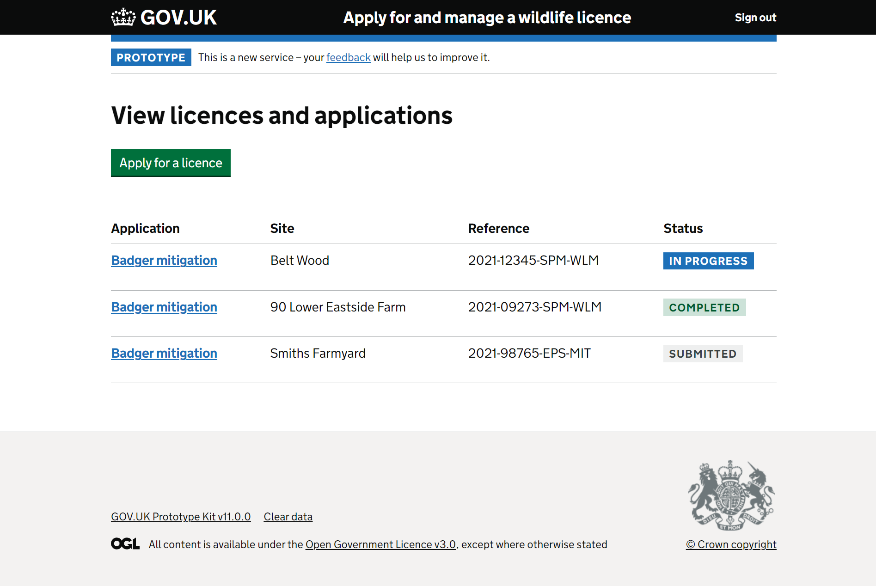
This page was understood
Participants who reached this page understood the status update in relation to the action they had just undertaken.

